Slide 1
Scalable Multi-Period Optimal Power Flow for Active Power Distribution Systems or simply, Scalable MP-OPF in ADS
Aryan Ritwajeet Jha
Graduate Research Assistant
Washington State University
Notes:
Remember to hit the reset button to make sure all the page elements react properly.
There are 20 different layouts that you can choose from.

Slide 2
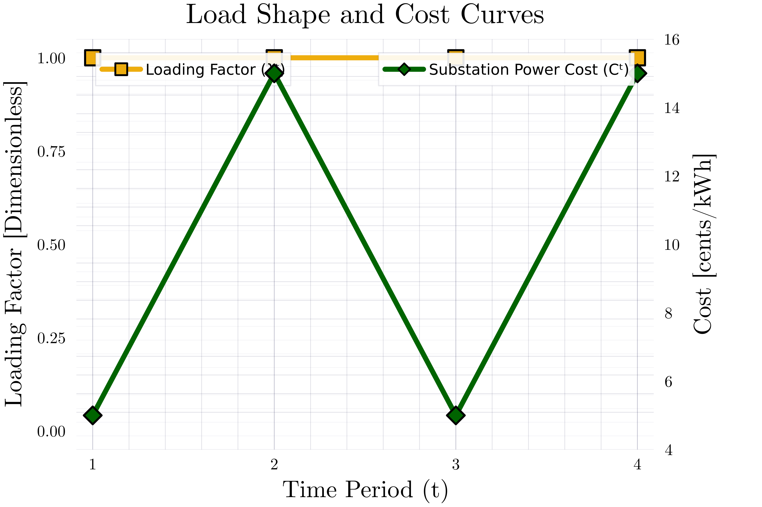
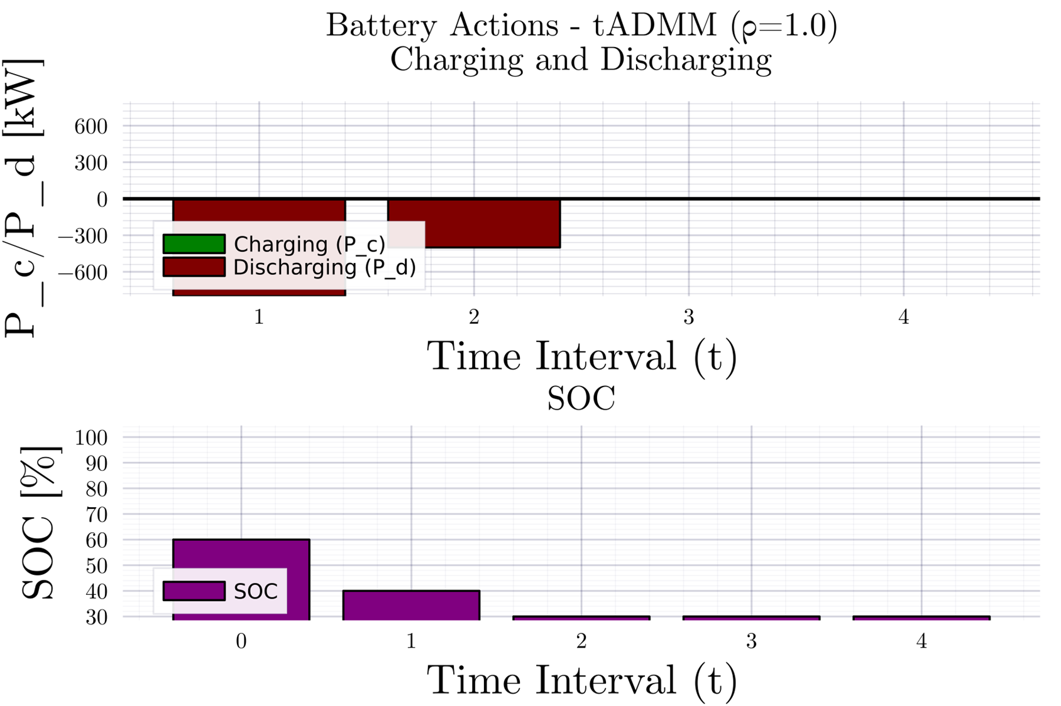
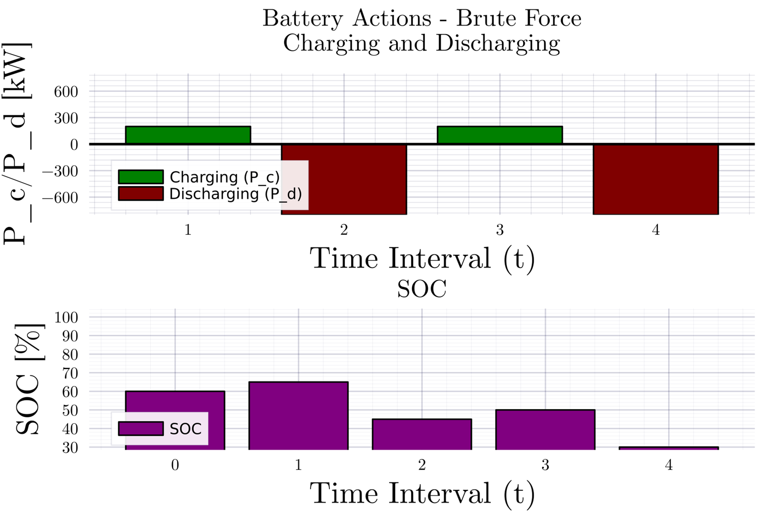
Consensus ADMM formulation for MPOPF $T=4$
Description

Slide 3
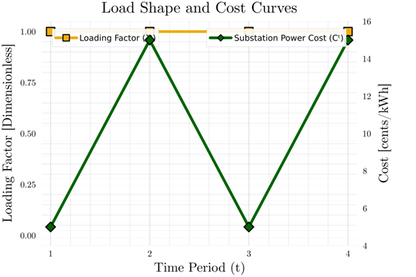
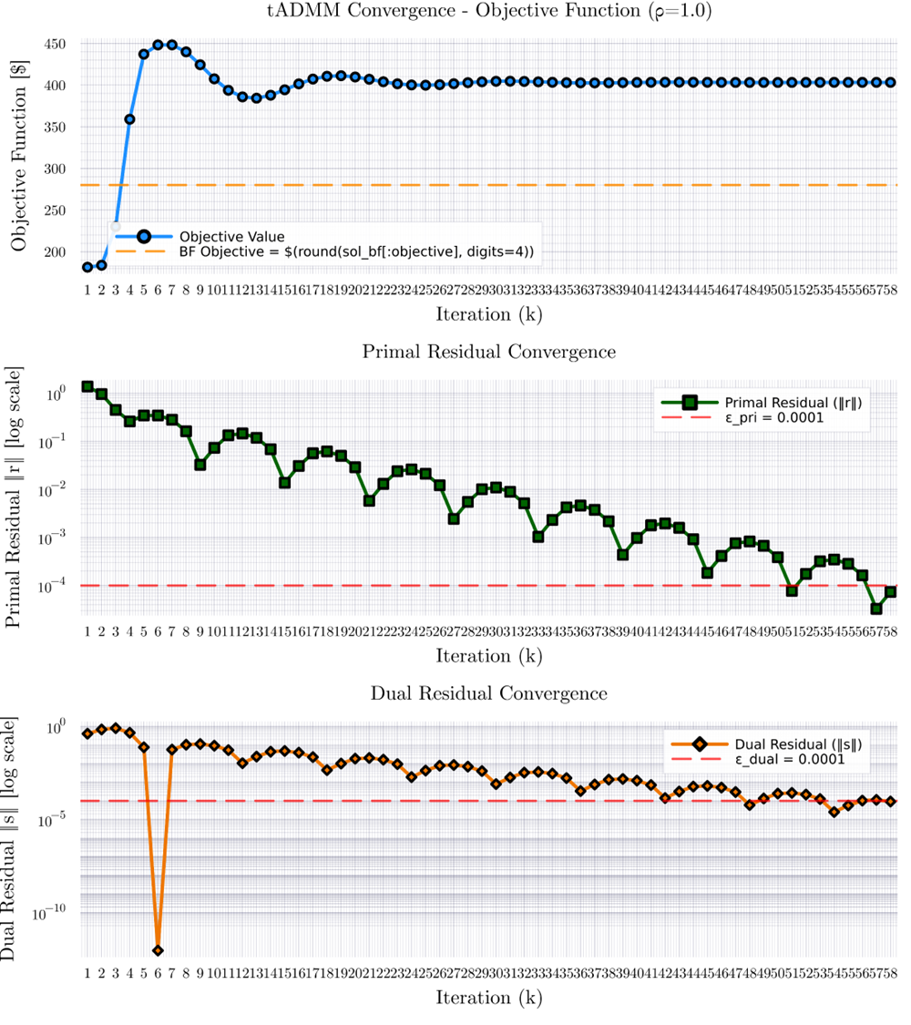
Consensus ADMM formulation for MPOPF $T=4$

Slide 4

Latest Slides End Here. Previous Slides Follow.

Slide 5
Consensus ADMM formulation for MPOPF $T=4$
Description

Slide 6
Consensus ADMM formulation for MPOPF $T=4$

Slide 7
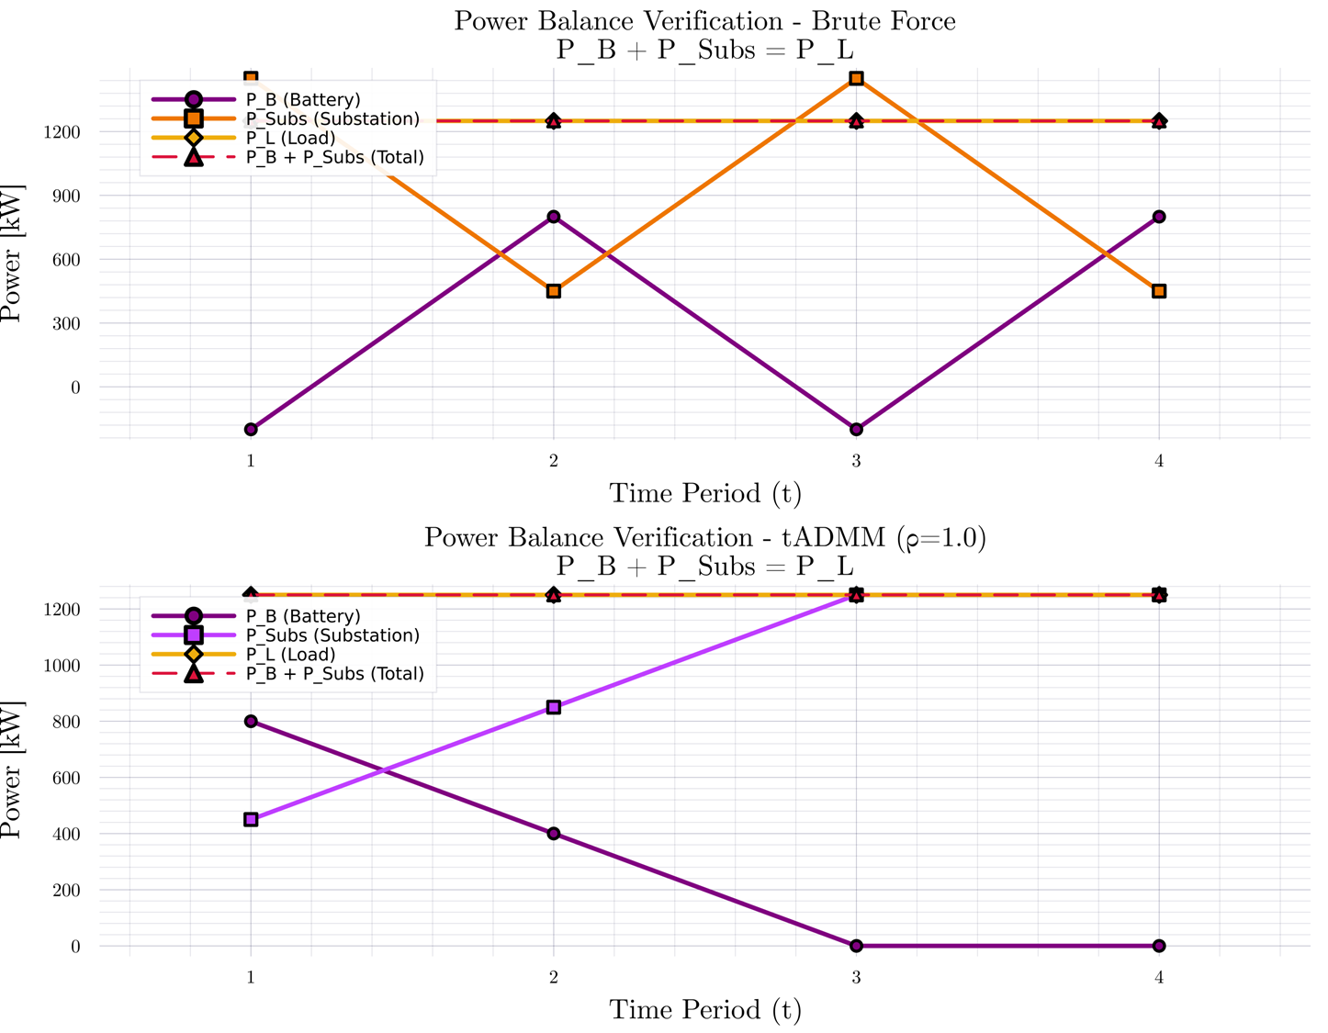
Consensus ADMM formulation for MPOPF $T=4$

Slide 8
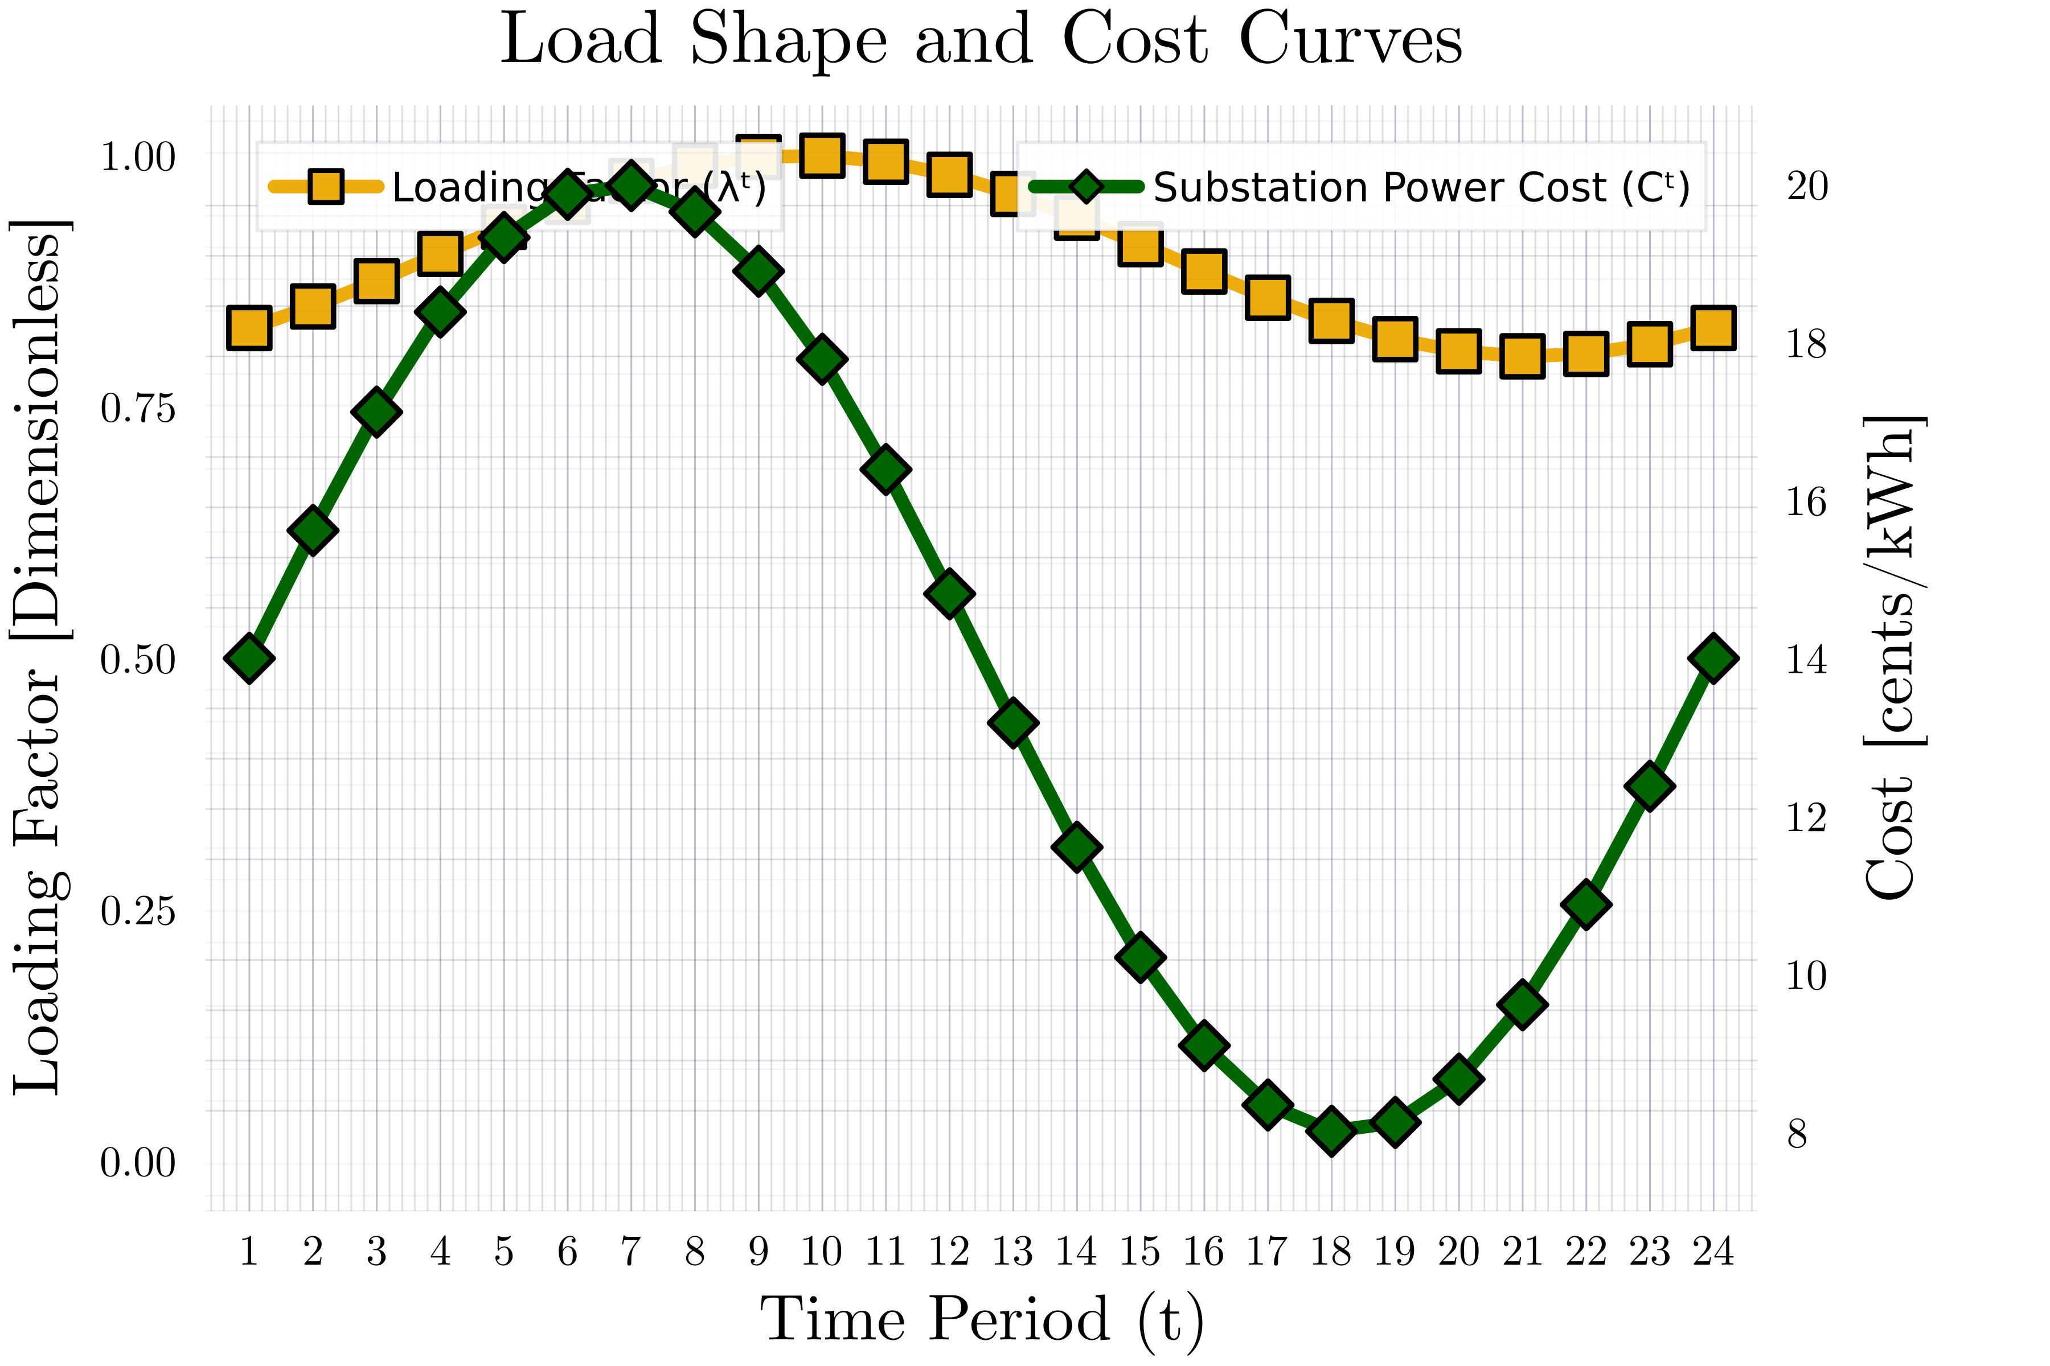
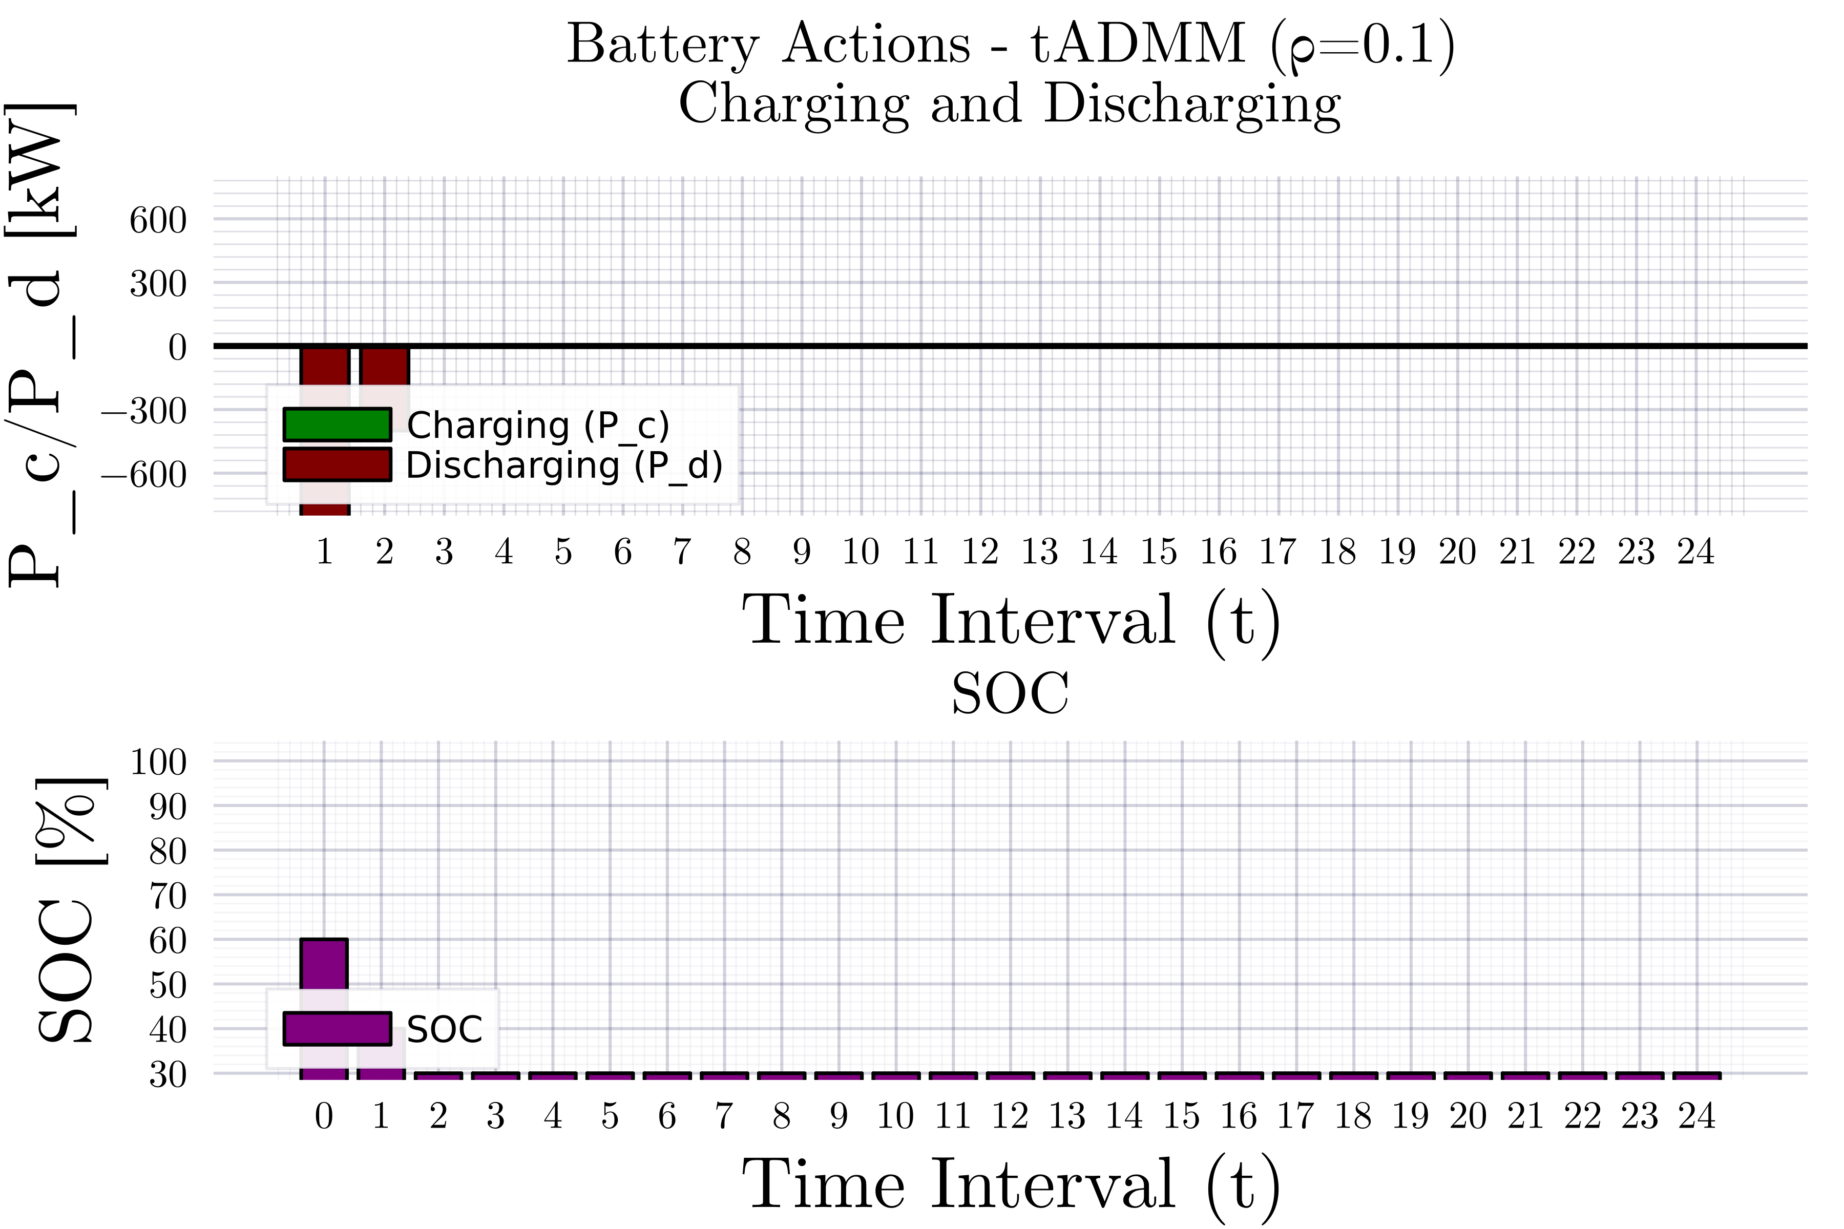
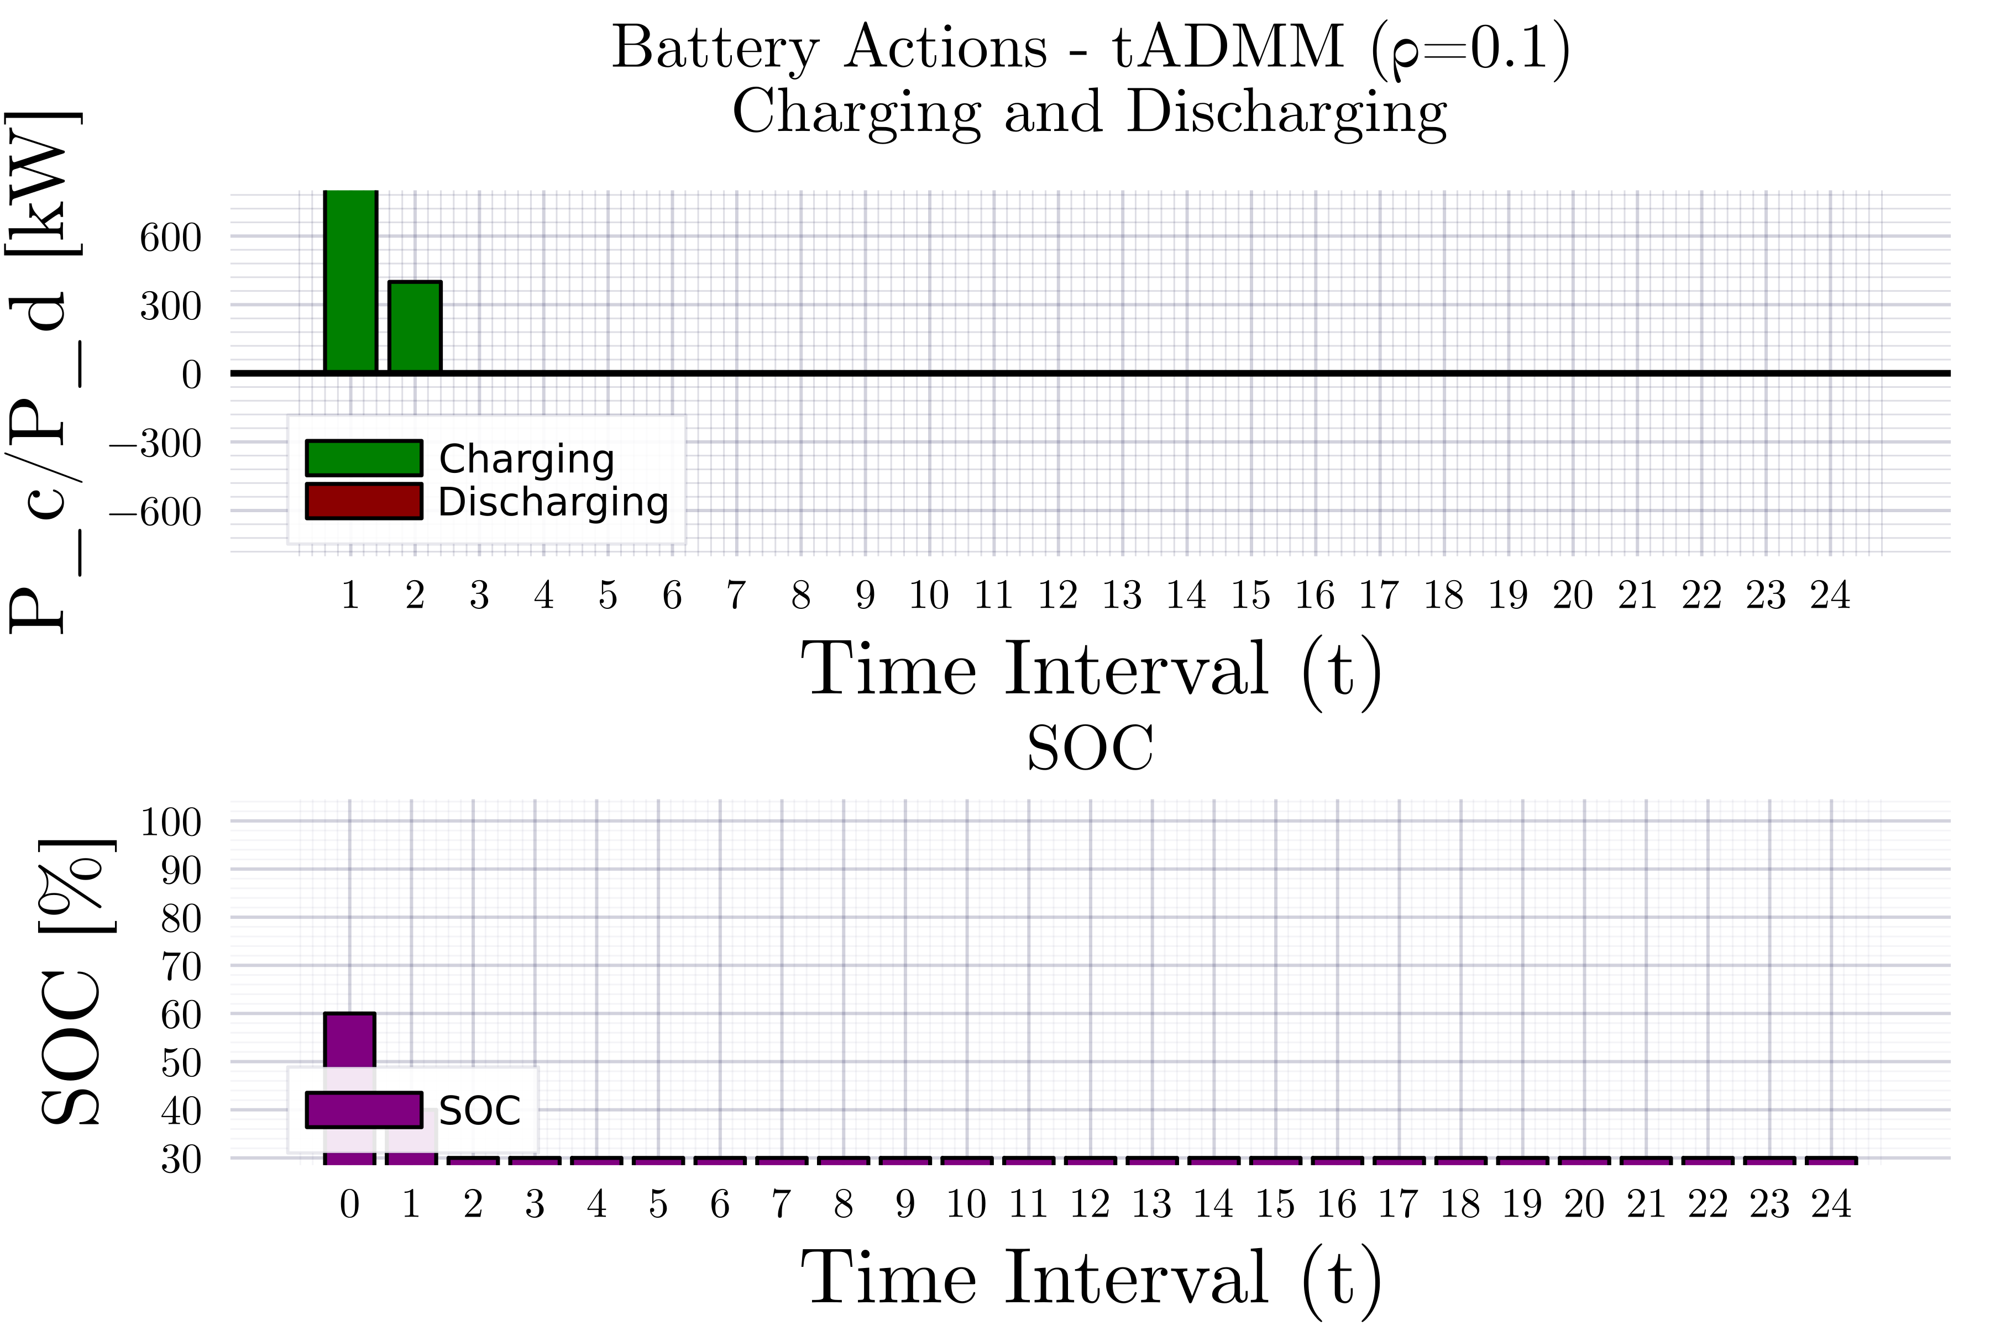
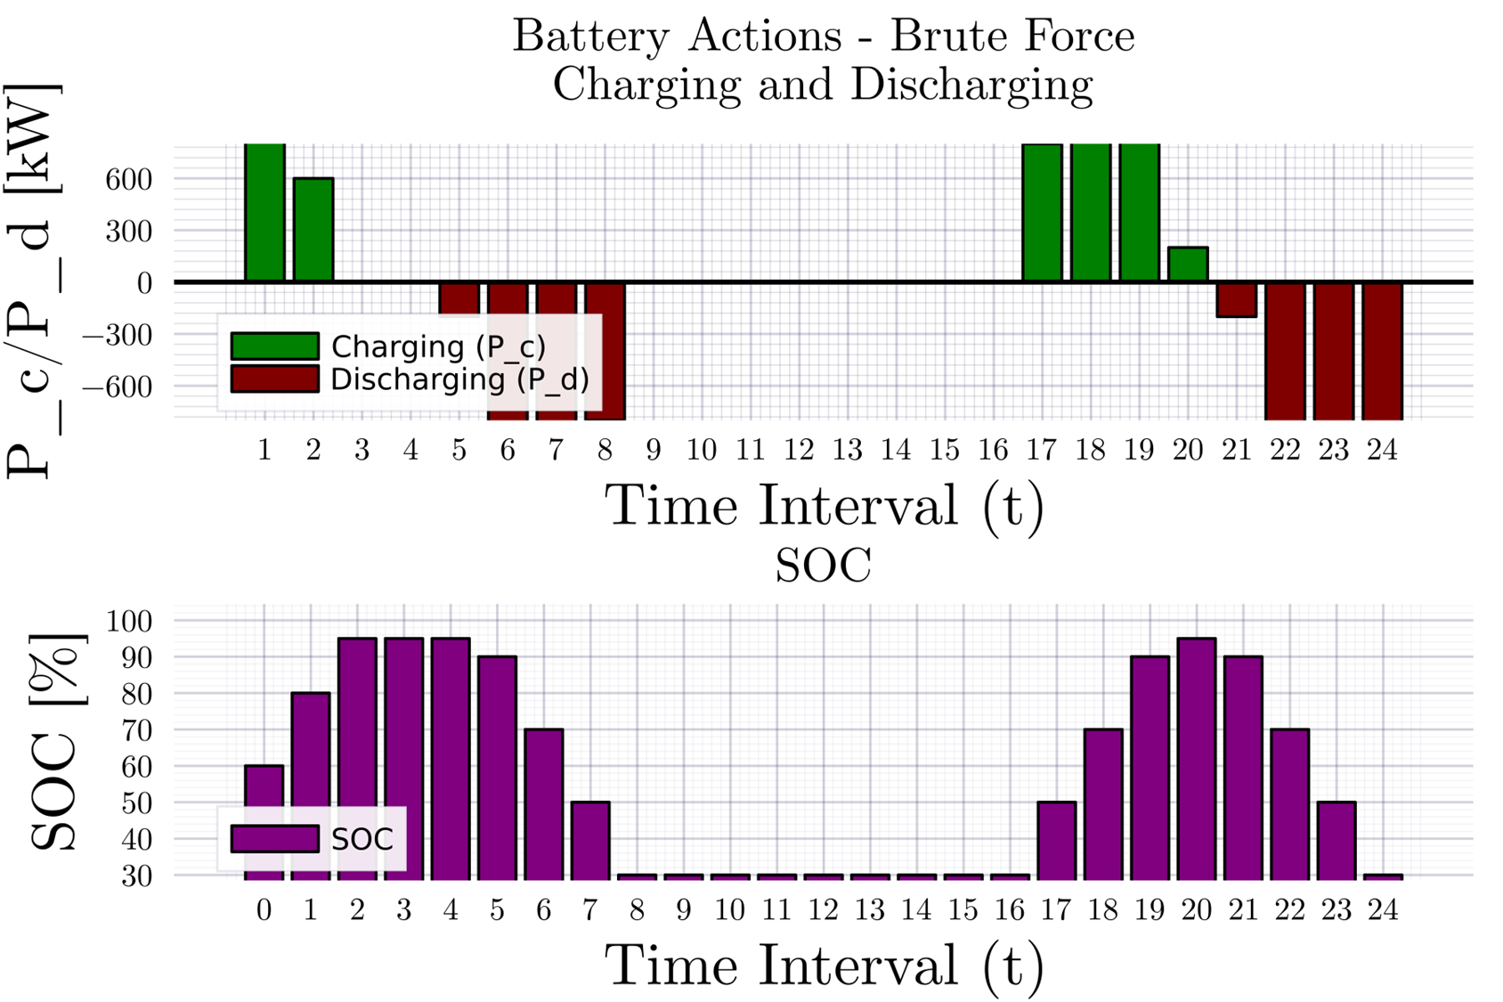
Consensus ADMM formulation for MPOPF
Description

Slide 9
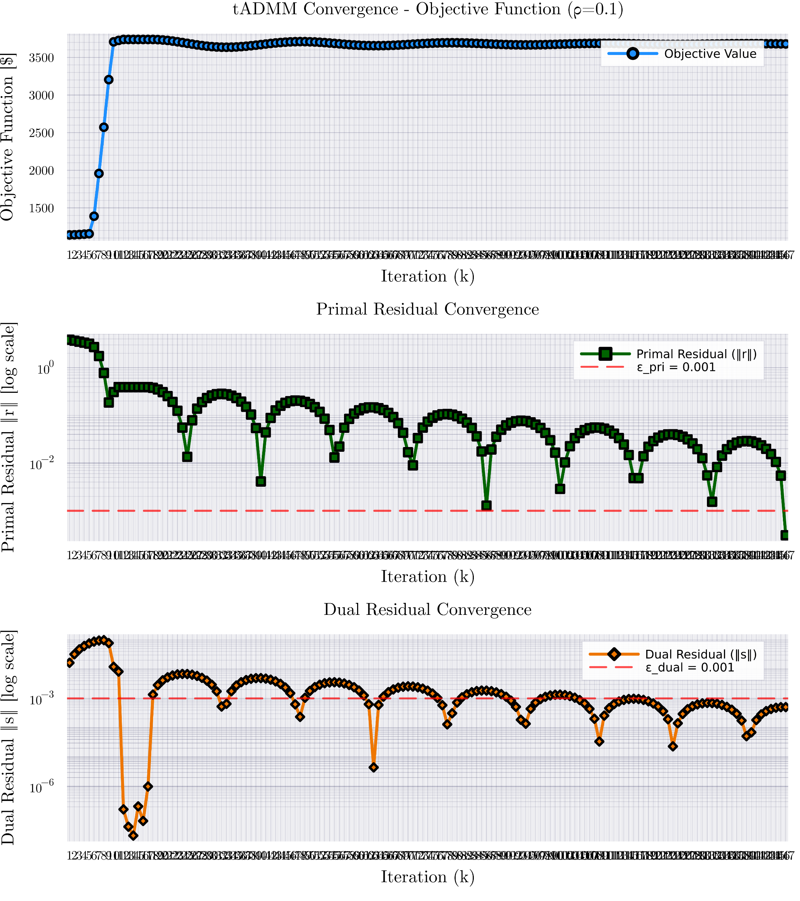
Consensus ADMM formulation for MPOPF

Slide 10
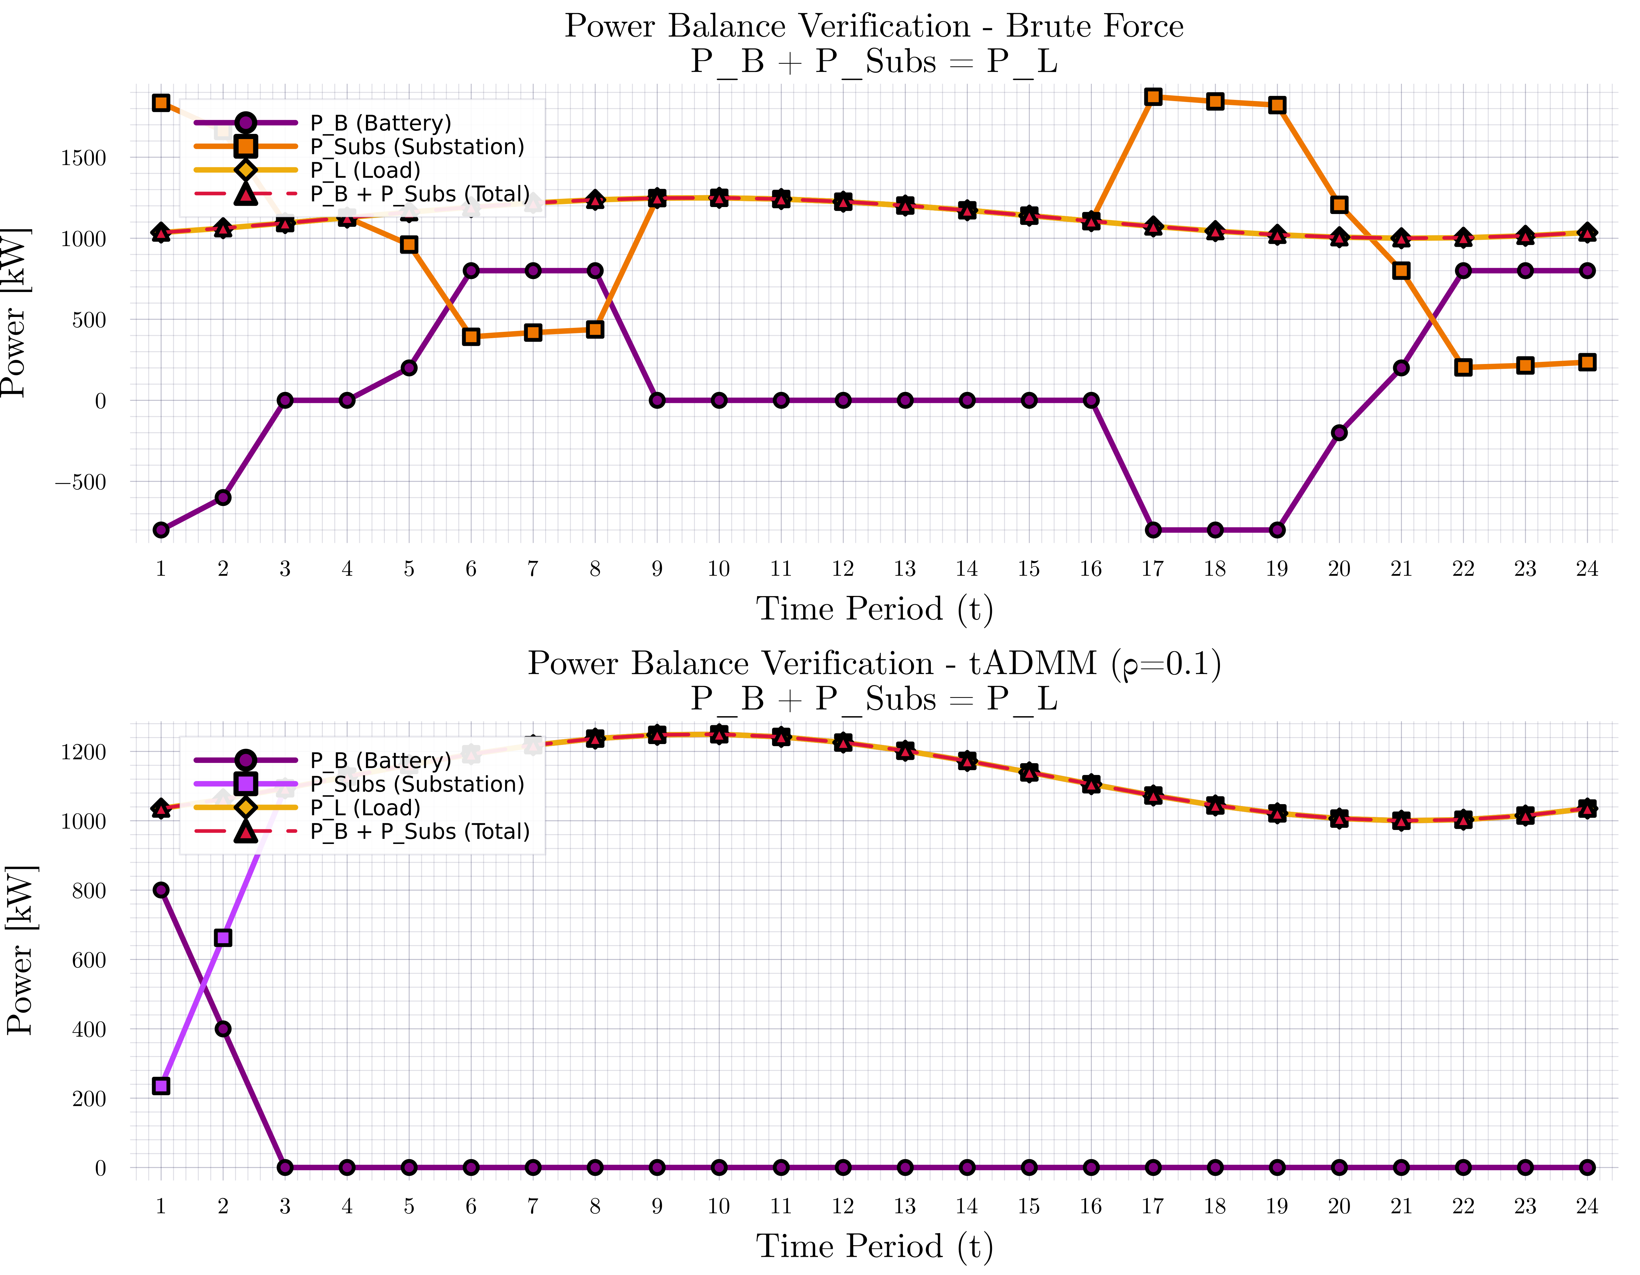
Consensus ADMM formulation for MPOPF

Slide 11
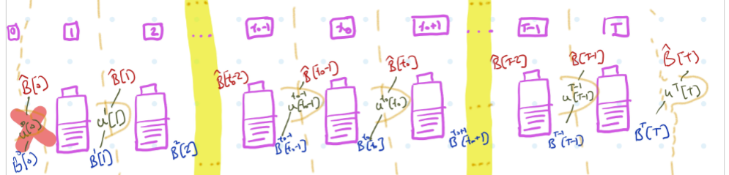
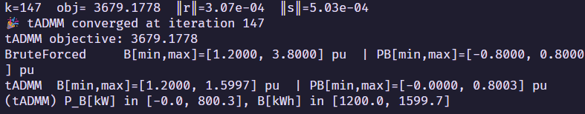
Consensus ADMM formulation for MPOPF
Description

Slide 12
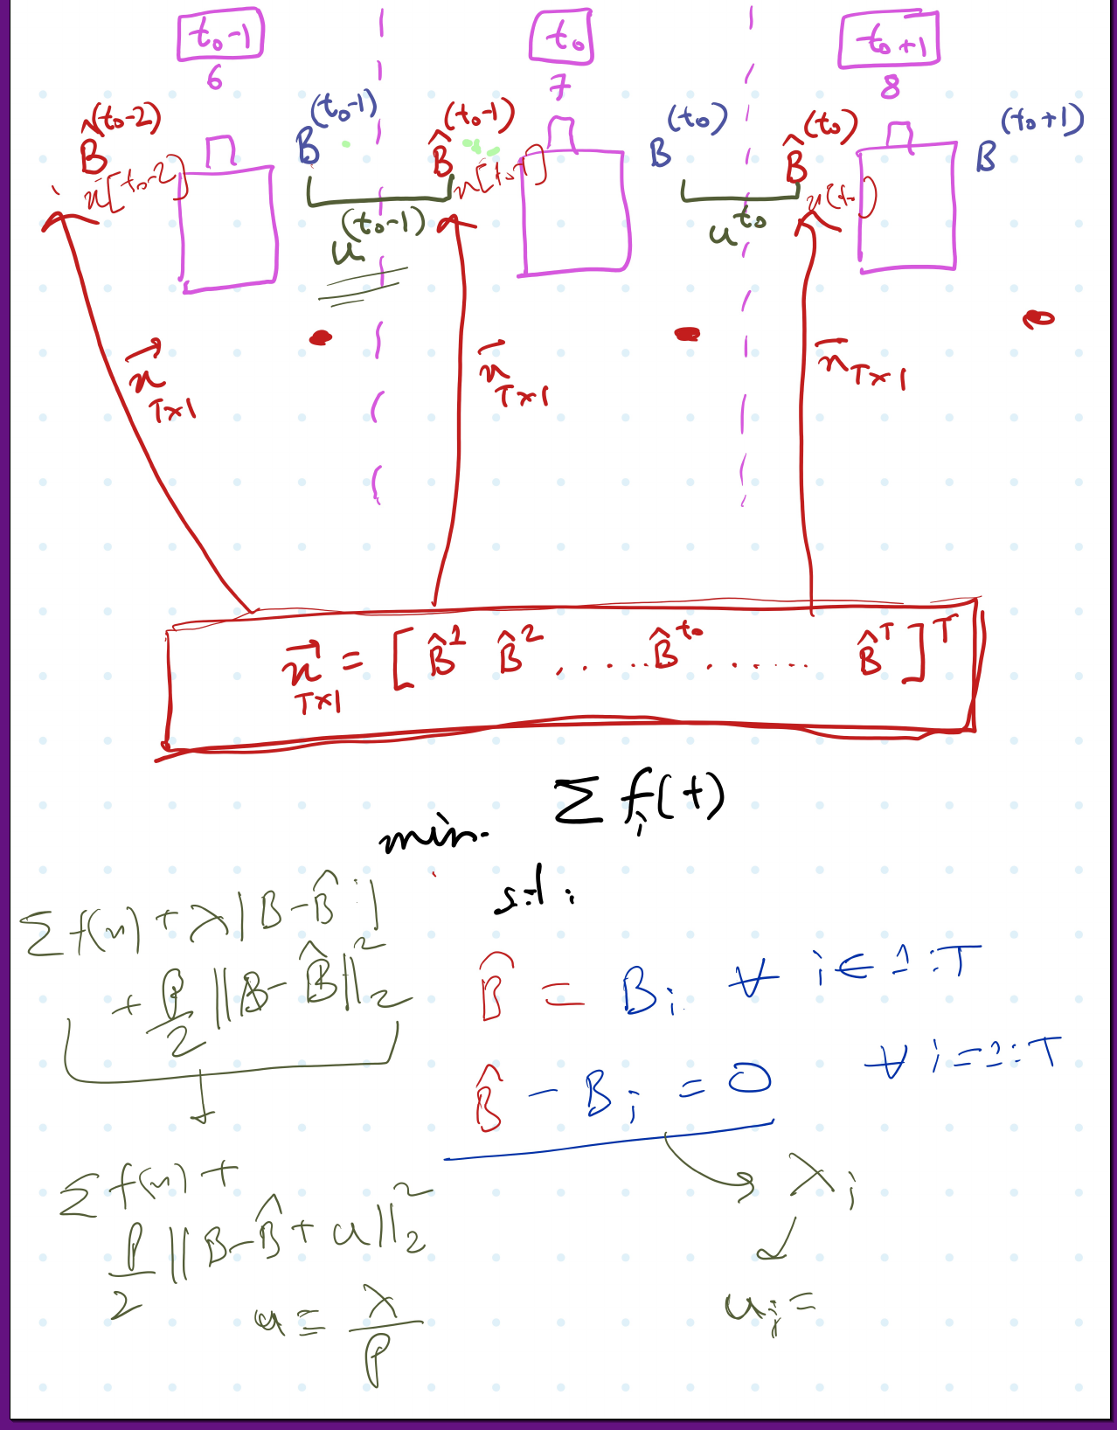
Consensus ADMM formulation for MPOPF
Description

Slide 13
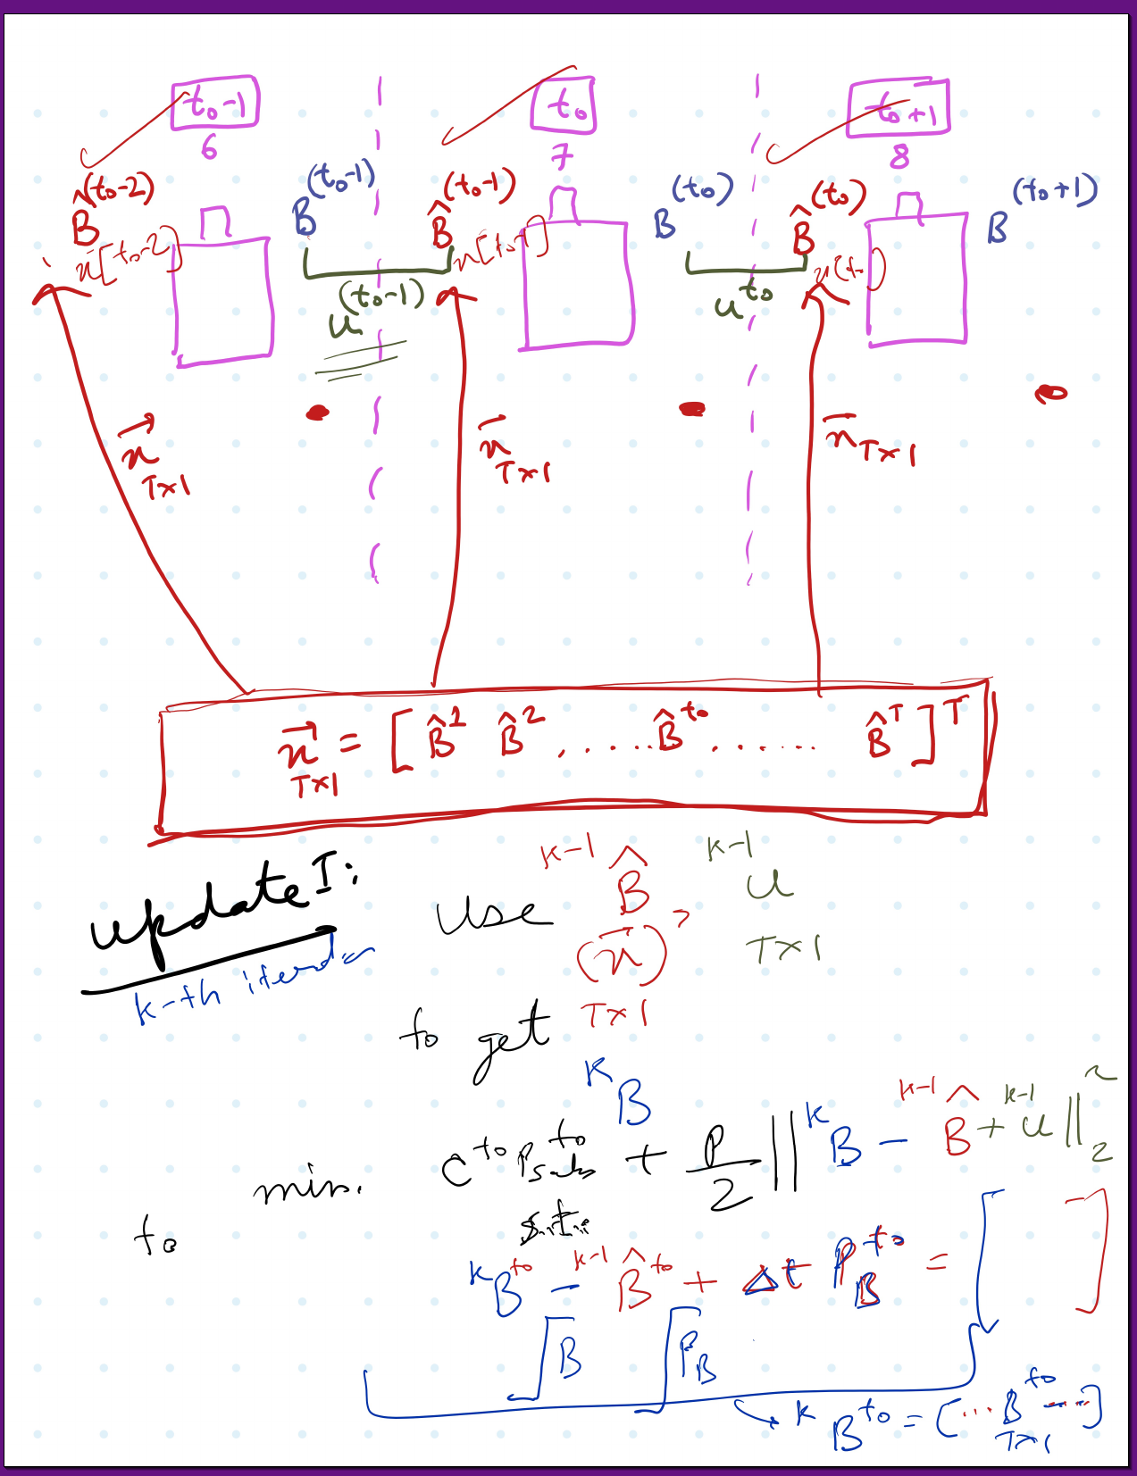
Consensus ADMM formulation for MPOPF
Description

Slide 14
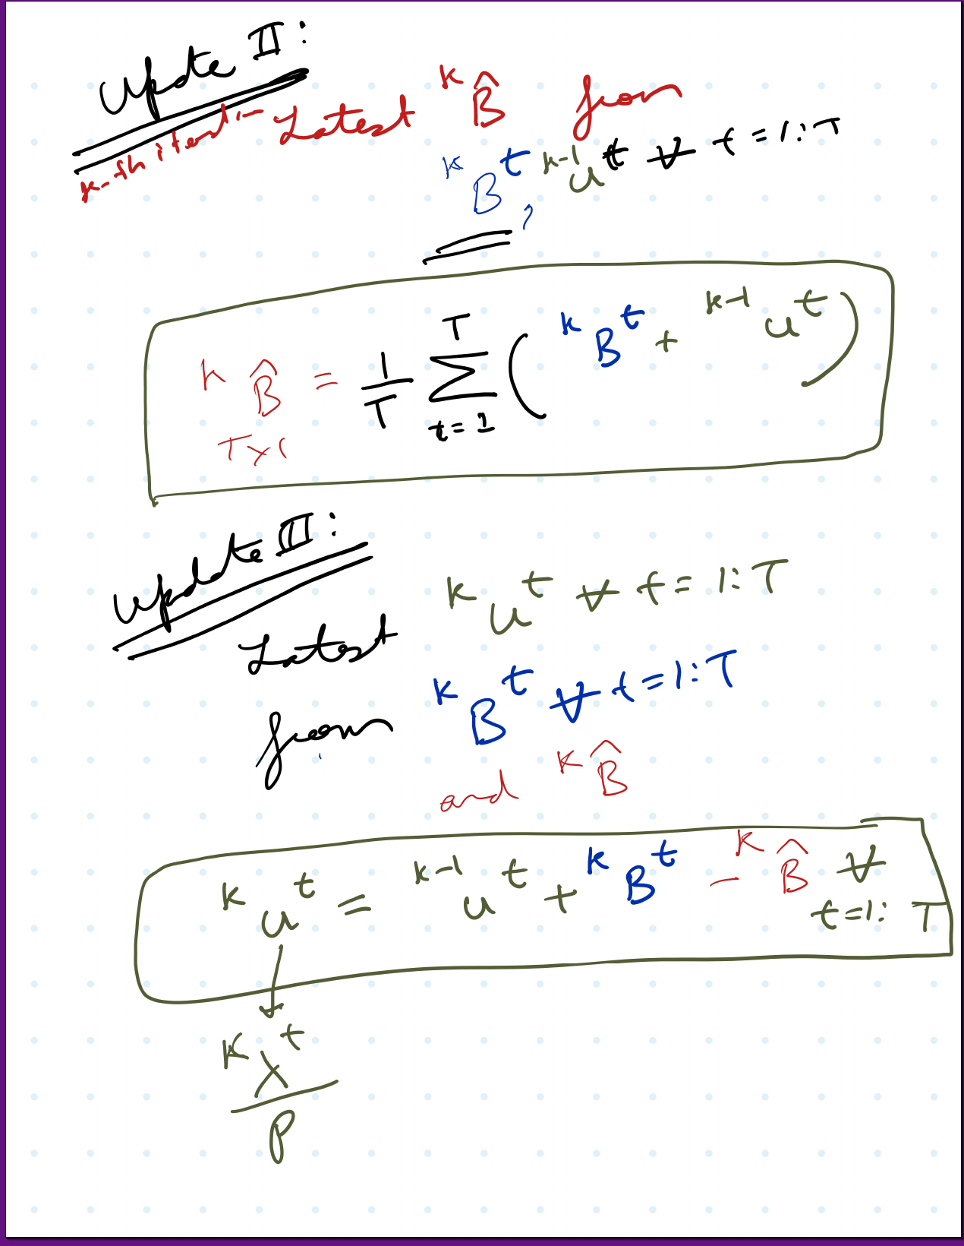
Consensus ADMM formulation for MPOPF
Description

Slide 15
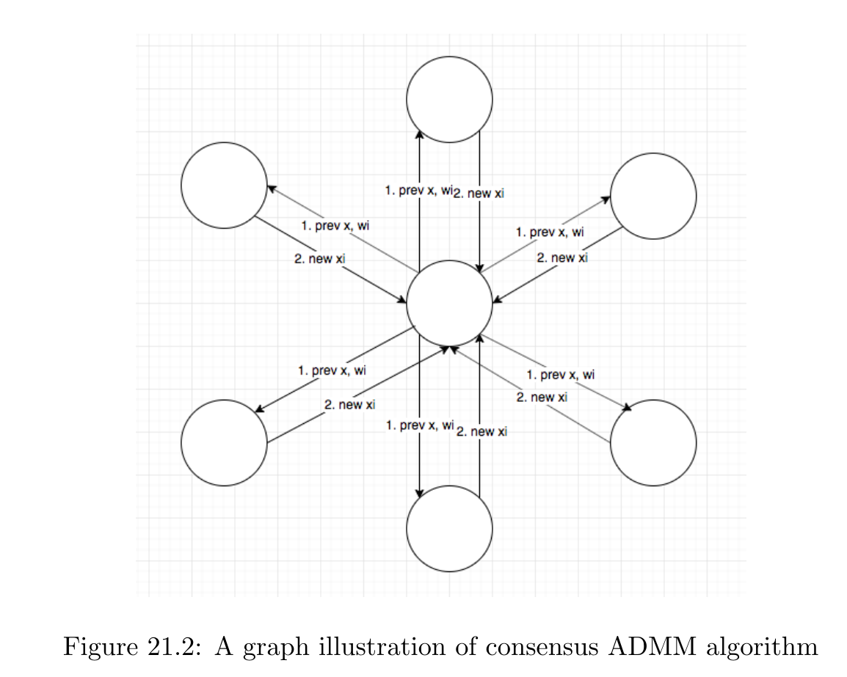
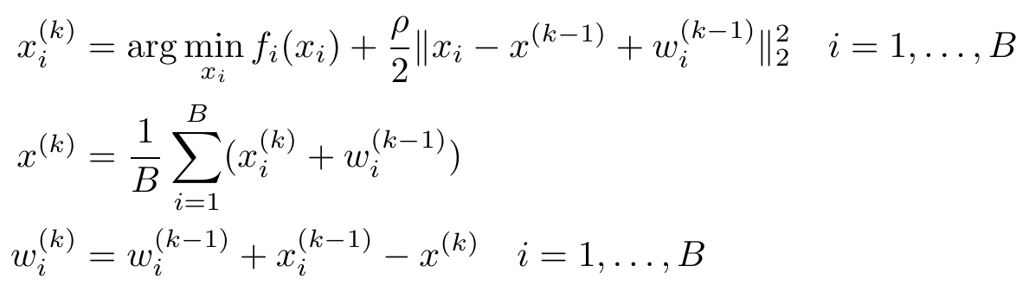
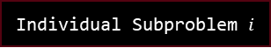
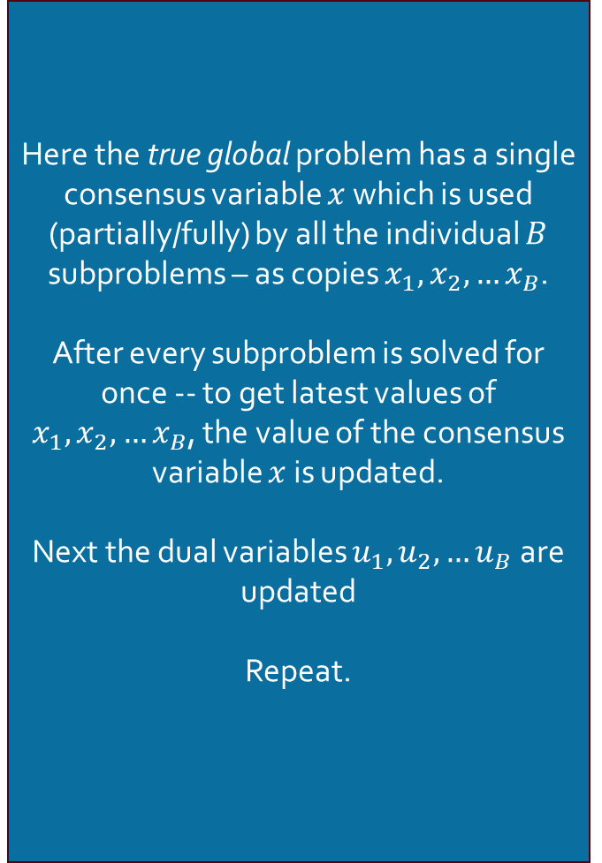
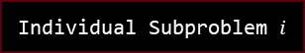
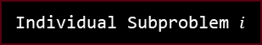

Consensus ADMM formulation
Graph Illustration
Here the true global problem has a single consensus variable $x$ which is used (partially/fully) by all the individual $B$ subproblems – as copies $x_{1},x_{2},…x_{B}$.
After every subproblem is solved for once -- to get latest values of $x_{1},x_{2},…x_{B}$, the value of the consensus variable $x$ is updated.
Next the dual variables $u_{1},u_{2},…u_{B}$ are updated
Repeat.
Individual Subproblem $i$
Individual Subproblem $i$
Individual Subproblem $i$
Global Problem
Individual Subproblem $i$
Individual Subproblem $i$
Individual Subproblem $i$
Source: [ADMM notes CMU]

Slide 16
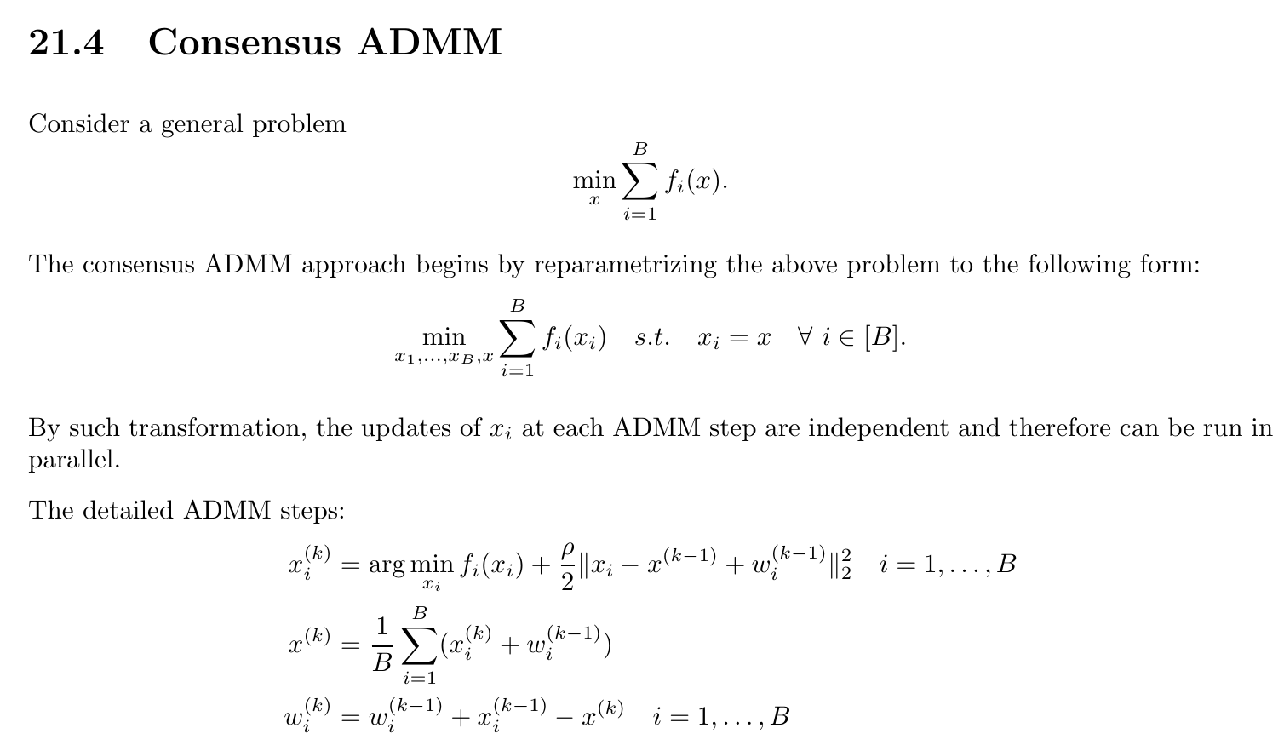
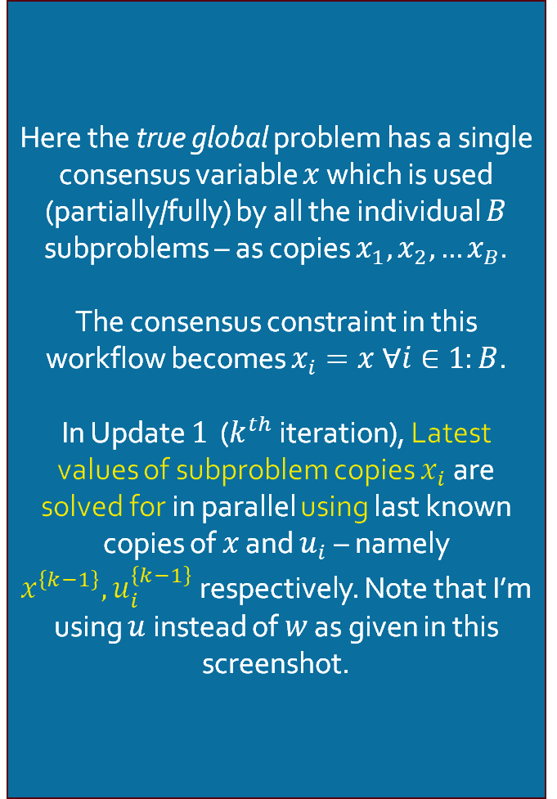

Consensus ADMM formulation
Update $1$: Solve for $x_{i}^{k} ∀i∈1:B$
Here the true global problem has a single consensus variable $x$ which is used (partially/fully) by all the individual $B$ subproblems – as copies $x_{1},x_{2},…x_{B}$.
The consensus constraint in this workflow becomes $x_{i}=x ∀i∈1:B$.
In Update $1$ ($k^{th}$ iteration), Latest values of subproblem copies $x_{i}$ are solved for in parallel using last known copies of $x$ and $u_{i}$ – namely $x^{\left\{k−1\right\}}, u_{i}^{\left\{k−1\right\}}$ respectively. Note that I’m using $u$ instead of $w$ as given in this screenshot.
Note: This is like a one-sided ADMM formluation
Source: [ADMM notes CMU]

Slide 17
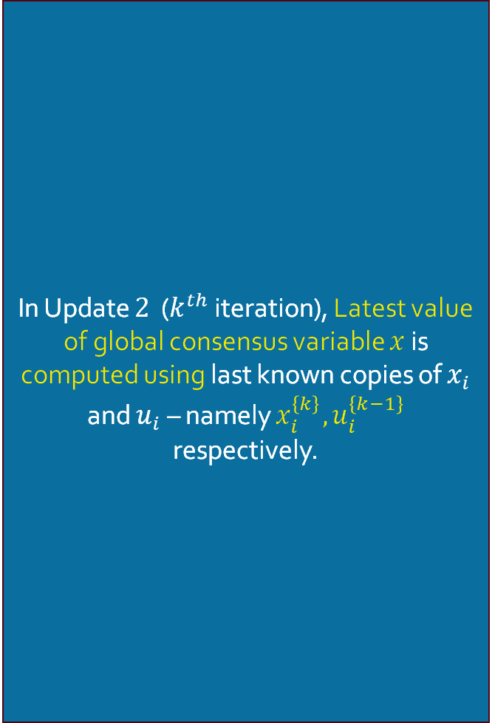

Consensus ADMM formulation
Update $2$: Solve for $x^{k}$
In Update $2$ ($k^{th}$ iteration), Latest value of global consensus variable $x$ is computed using last known copies of $x_{i}$ and $u_{i}$ – namely $x_{i}^{\left\{k\right\}}, u_{i}^{\left\{k−1\right\}}$ respectively.

Slide 18
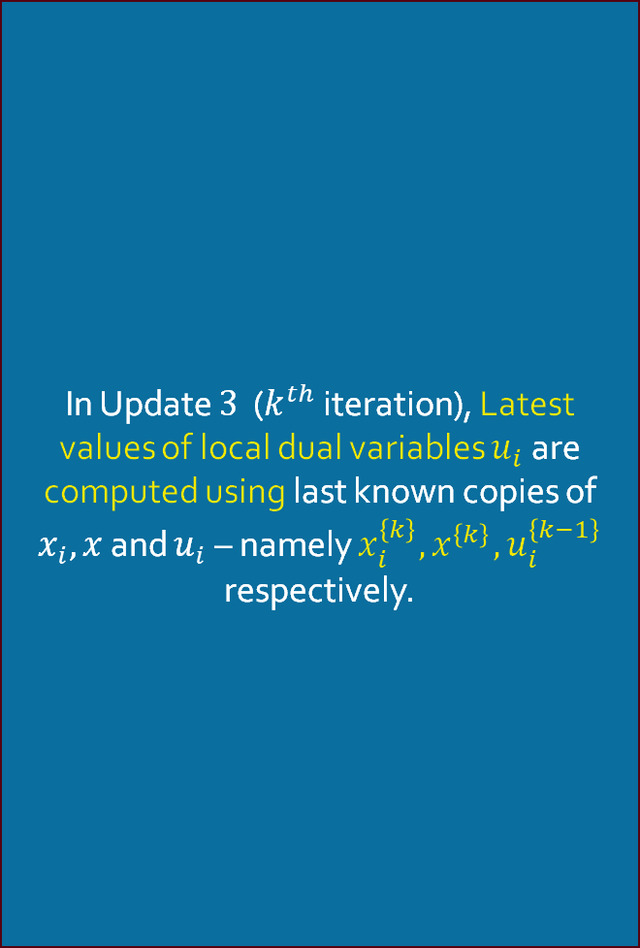

Consensus ADMM formulation
Update $3$: Solve for $u_{i}^{k} ∀ i∈1:B$
In Update $3$ ($k^{th}$ iteration), Latest values of local dual variables $u_{i}$ are computed using last known copies of $x_{i}, x$ and $u_{i}$ – namely $x_{i}^{\left\{k\right\}}, x^{\left\{k\right\}},u_{i}^{\left\{k−1\right\}}$ respectively.

Slide 19
Consensus ADMM formulation
Graph Illustration
Individual Subproblem $i$
Individual Subproblem $i$
Individual Subproblem $i$
Global Problem
Individual Subproblem $i$
Individual Subproblem $i$
Individual Subproblem $i$

Slide 20
Consensus ADMM formulation for MPOPF
Description

Slide 21
Consensus ADMM formulation for MPOPF
Description

Slide 22
Consensus ADMM formulation for MPOPF
Description

Slide 23
References
[ADMM notes CMU] Index of /~ryantibs/convexopt/scribes. (2025, September 01). Retrieved from https://www.stat.cmu.edu/~ryantibs/convexopt/scribes

Slide 24
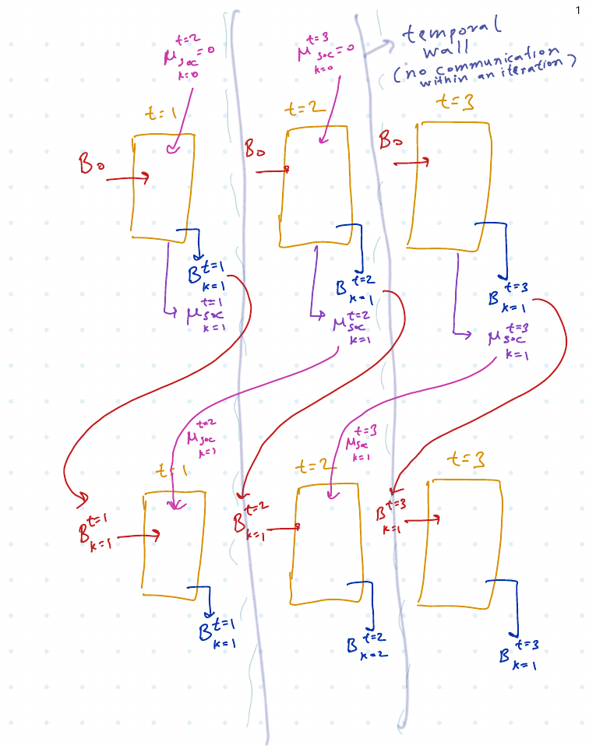

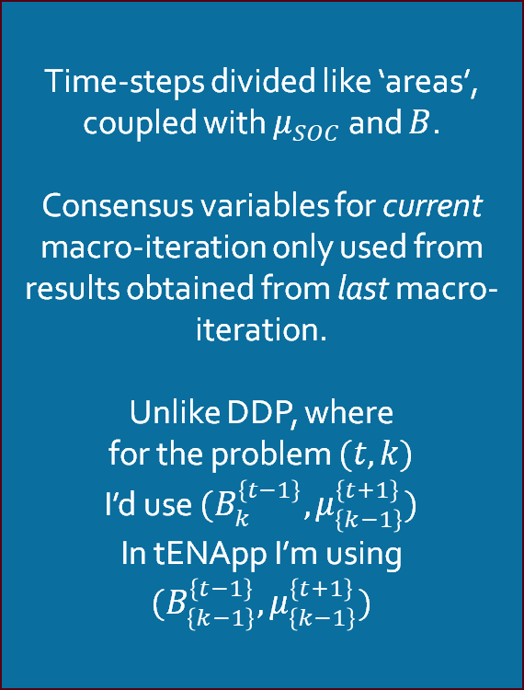
tENApp Algorithm Terminal SOC Constraint Relaxed
$$tENApp$$
Time-steps divided like ‘areas’, coupled with $μ_{SOC}$ and $B$.
Consensus variables for current macro-iteration only used from results obtained from last macro-iteration.
Unlike DDP, where
for the problem $(t, k)$
I’d use $(B_{k}^{\left\{t−1\right\}}, μ_{\left\{k−1\right\}}^{\left\{t+1\right\}})$
In tENApp I’m using $(B_{\left\{k−1\right\}}^{\left\{t−1\right\}}, μ_{\left\{k−1\right\}}^{\left\{t+1\right\}})$

Slide 25
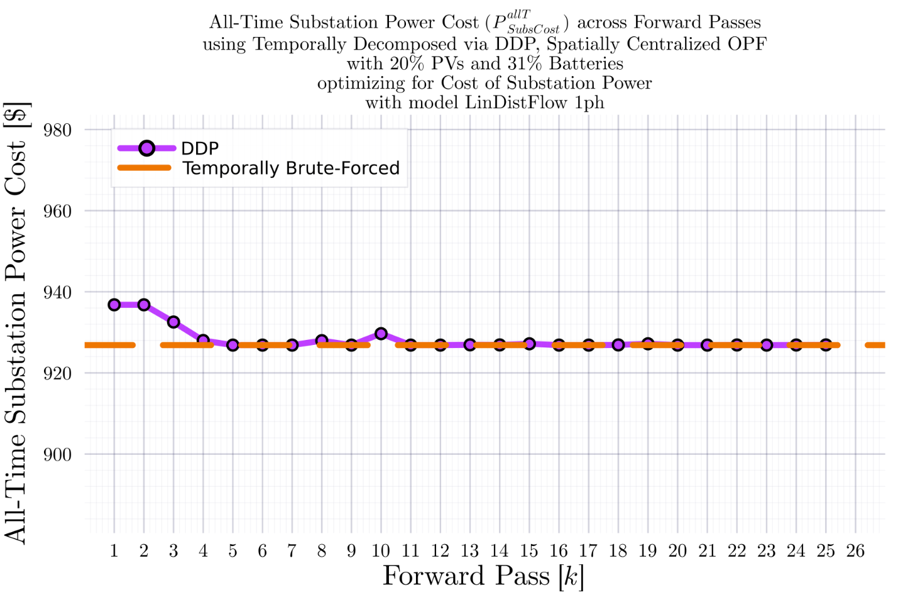
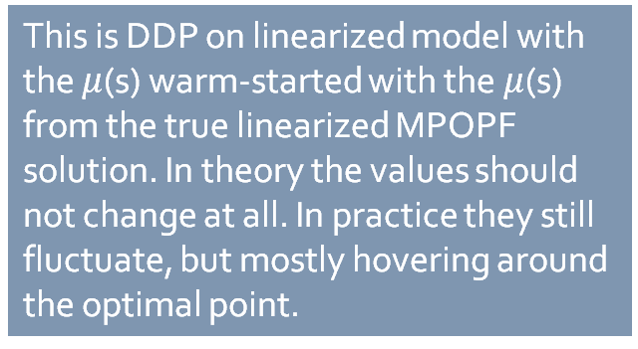
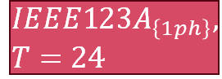
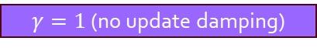


DDP Trajectory vs #Forward Passes $[k]$: LinDistFlow Model Terminal SOC Constraint Relaxed
$$IEEE123A_{\left\{1ph\right\}}, T=24$$
BruteForced (BF)
$$DDP$$
This is DDP on linearized model with the $μ$(s) warm-started with the $μ$(s) from the true linearized MPOPF solution. In theory the values should not change at all. In practice they still fluctuate, but mostly hovering around the optimal point.
$γ=1$ (no update damping)
$$k_{Max}=25$$

Slide 26
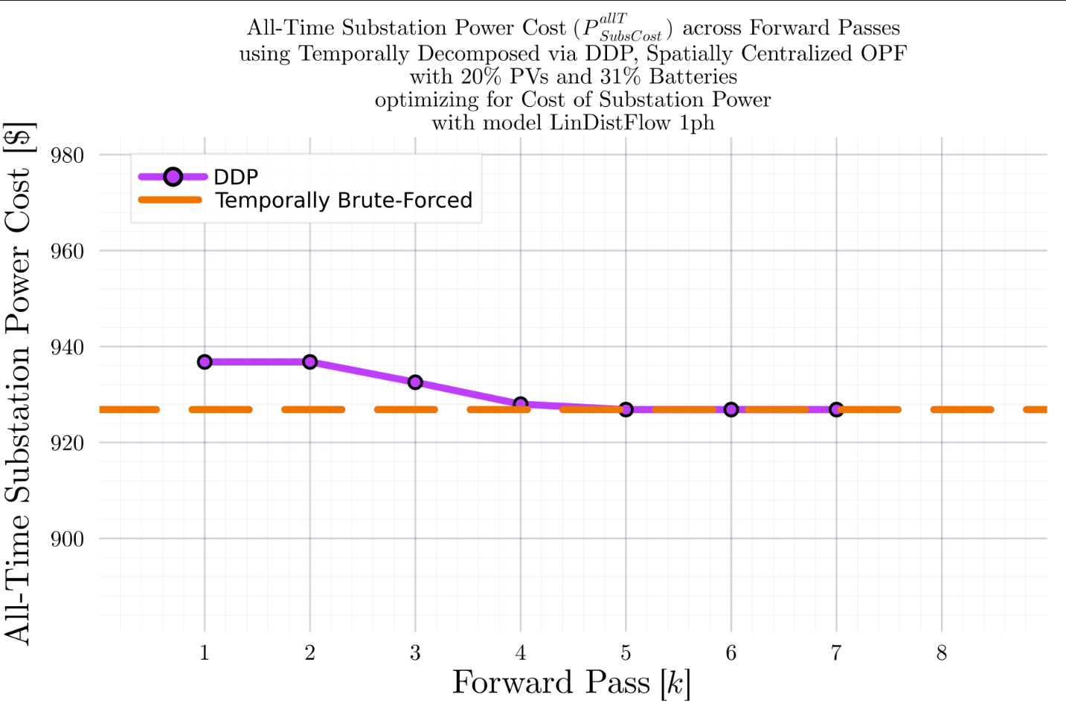
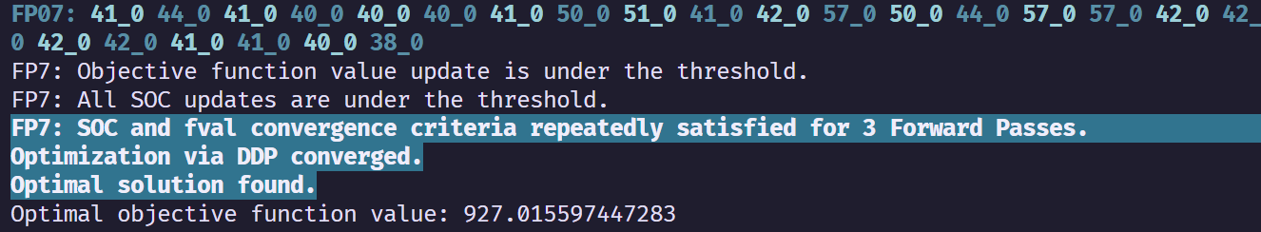
DDP Trajectory vs #Forward Passes $[k]$: LinDistFlow Model Terminal SOC Constraint Relaxed
$$IEEE123A_{\left\{1ph\right\}}, T=24$$
BruteForced (BF)
$$DDP$$
With some ‘convergence-catching’ heuristic in place (declare convergence if SOC and fval are not changing for 3 Forward Passes), DDP converges.
$γ=1$ (no update damping)
$$k_{Max}=25$$

Slide 27
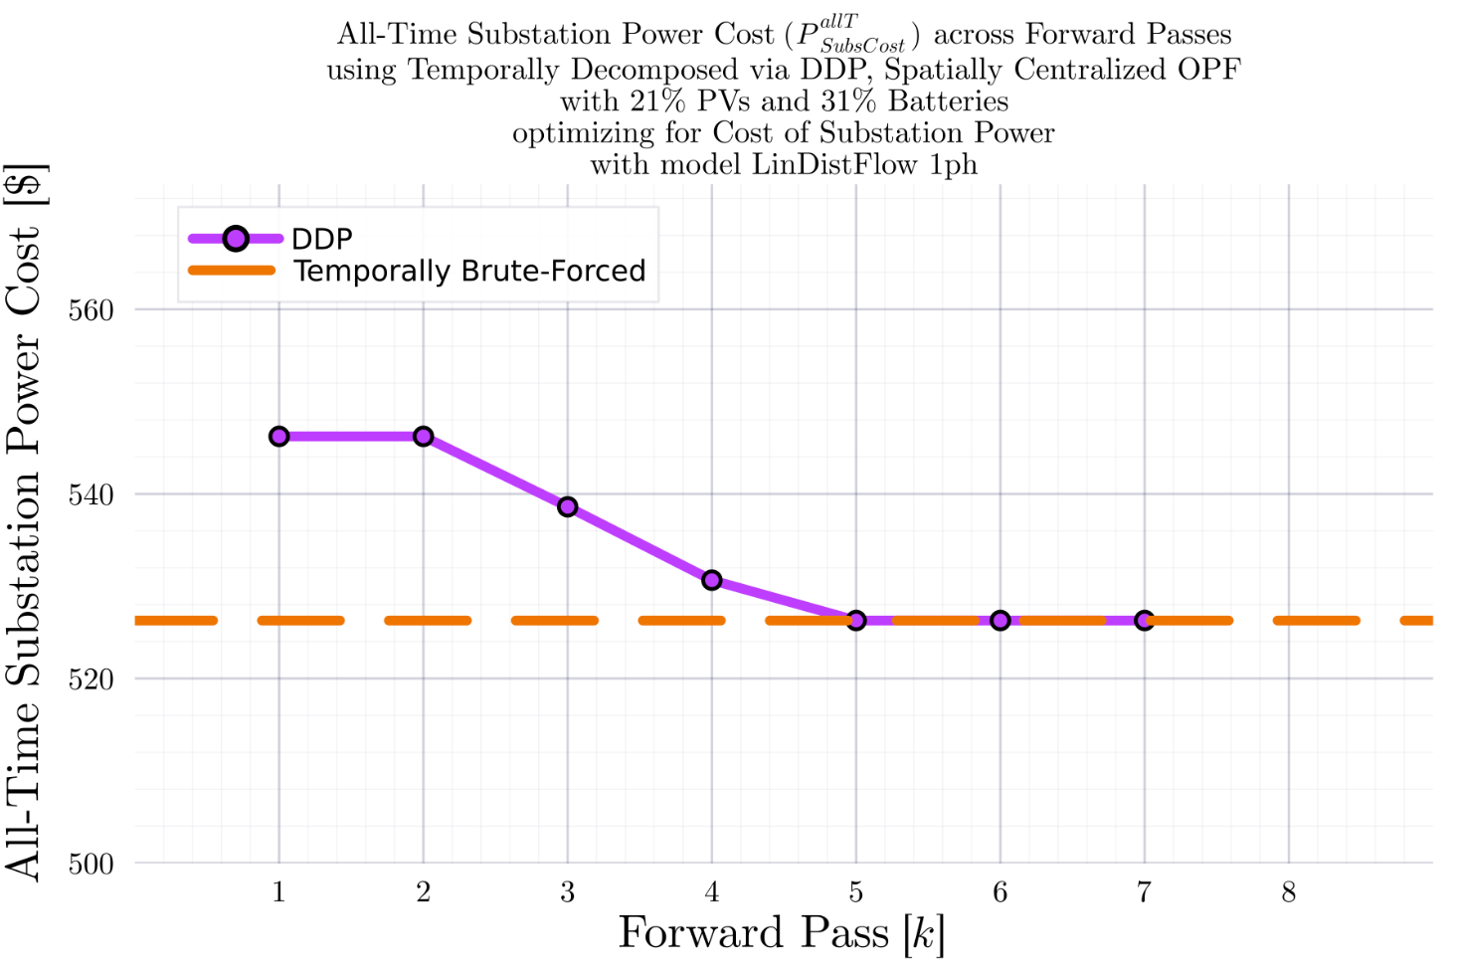
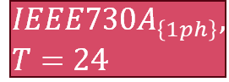
DDP Trajectory vs #Forward Passes $[k]$: LinDistFlow Model Terminal SOC Constraint Relaxed
$$IEEE730A_{\left\{1ph\right\}}, T=24$$
BruteForced (BF)
$$DDP$$
With some ‘convergence-catching’ heuristic in place (declare convergence if SOC and fval are not changing for 3 Forward Passes), DDP converges.
$γ=1$ (no update damping)
$$k_{Max}=25$$

Slide 28
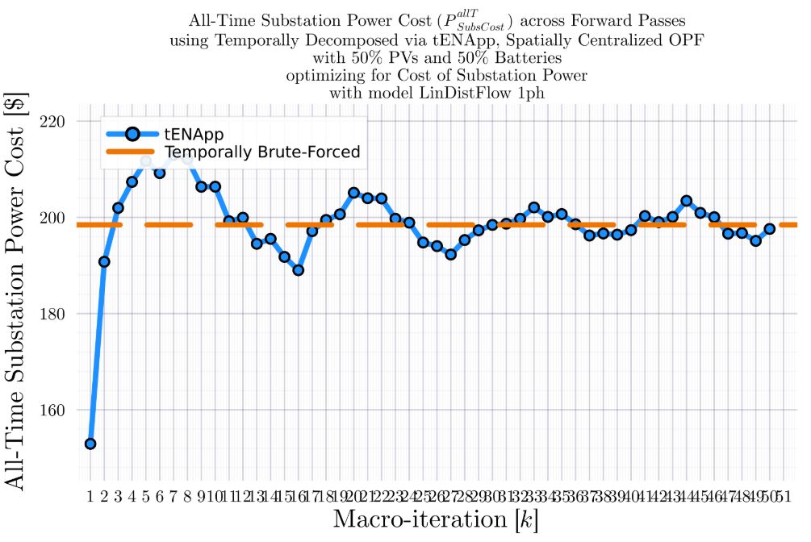
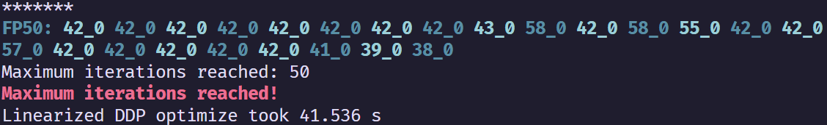
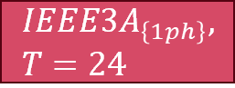



tENApp Trajectory vs #Forward Passes $[k]$: LinDistFlow Model Terminal SOC Constraint Relaxed
$$IEEE3A_{\left\{1ph\right\}}, T=24$$
BruteForced (BF)
$$tENApp$$
$γ=1$ (no update damping)
$$k_{Max}=50$$
$$α=4.00$$

Slide 29
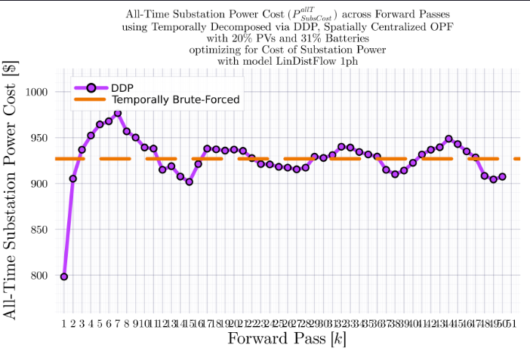
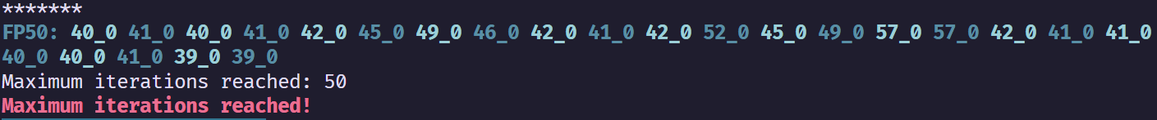
tENApp Trajectory vs #Forward Passes $[k]$: LinDistFlow Model Terminal SOC Constraint Relaxed
$$IEEE123A_{\left\{1ph\right\}}, T=24$$
BruteForced (BF)
$$tENApp$$
$γ=1$ (no update damping)
$$k_{Max}=50$$

Slide 30
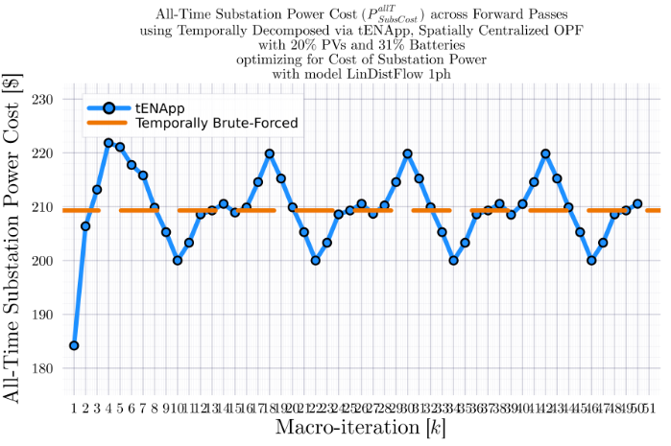
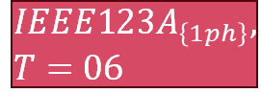

tENApp Trajectory vs #Forward Passes $[k]$: LinDistFlow Model Terminal SOC Constraint Relaxed
$$IEEE123A_{\left\{1ph\right\}}, T=06$$
BruteForced (BF)
$$tENApp$$
$γ=1$ (no update damping)
$$k_{Max}=50$$
$$α=1.00$$

Slide 31

tENApp Trajectory vs #Forward Passes $[k]$: LinDistFlow Model Terminal SOC Constraint Relaxed
$$IEEE123A_{\left\{1ph\right\}}, T=06$$
BruteForced (BF)
$$tENApp$$
$γ=1$ (no update damping)
$$k_{Max}=50$$
$$α=0.43$$

Slide 32

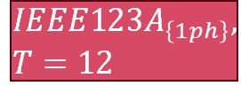

tENApp Trajectory vs #Forward Passes $[k]$: LinDistFlow Model Terminal SOC Constraint Relaxed
$$IEEE123A_{\left\{1ph\right\}}, T=12$$
BruteForced (BF)
$$tENApp$$
$γ=1$ (no update damping)
$$k_{Max}=100$$
$$α=0.43$$

Slide 33
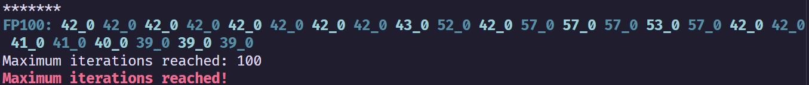

tENApp Trajectory vs #Forward Passes $[k]$: LinDistFlow Model Terminal SOC Constraint Relaxed
$$IEEE123A_{\left\{1ph\right\}}, T=24$$
BruteForced (BF)
$$tENApp$$
$γ=1$ (no update damping)
$$k_{Max}=100$$
$$α=3.00$$

Slide 34
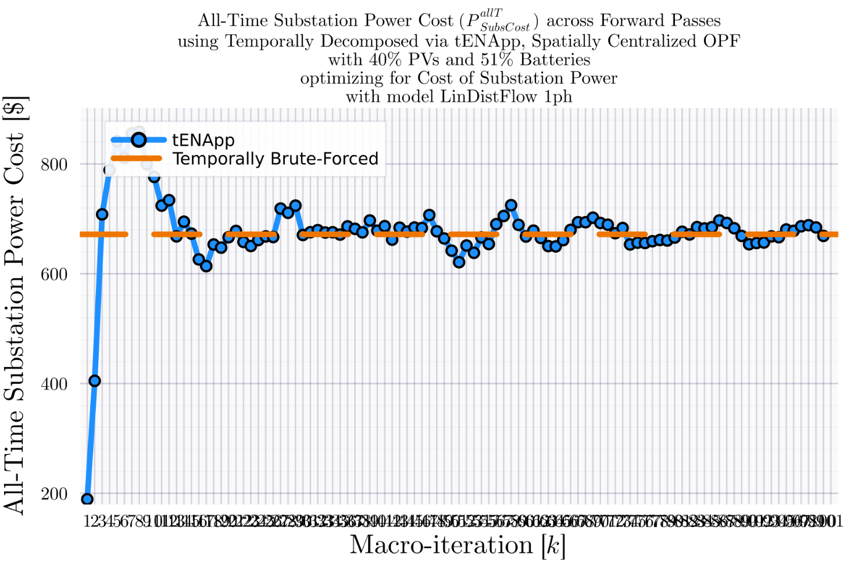
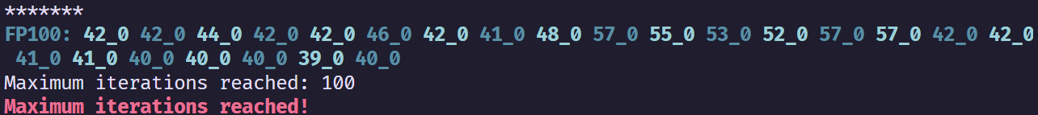
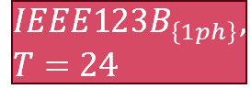
tENApp Trajectory vs #Forward Passes $[k]$: LinDistFlow Model Terminal SOC Constraint Relaxed
$$IEEE123B_{\left\{1ph\right\}}, T=24$$
BruteForced (BF)
$$tENApp$$
$γ=1$ (no update damping)
$$k_{Max}=100$$
$$α=3.00$$

Slide 35

tENApp Trajectory vs #Forward Passes $[k]$: LinDistFlow Model Terminal SOC Constraint Relaxed
$$IEEE123A_{\left\{1ph\right\}}, T=12$$
BruteForced (BF)
$$tENApp$$
$γ=1$ (no update damping)
$$k_{Max}=100$$
$$α=0.75$$

Slide 36
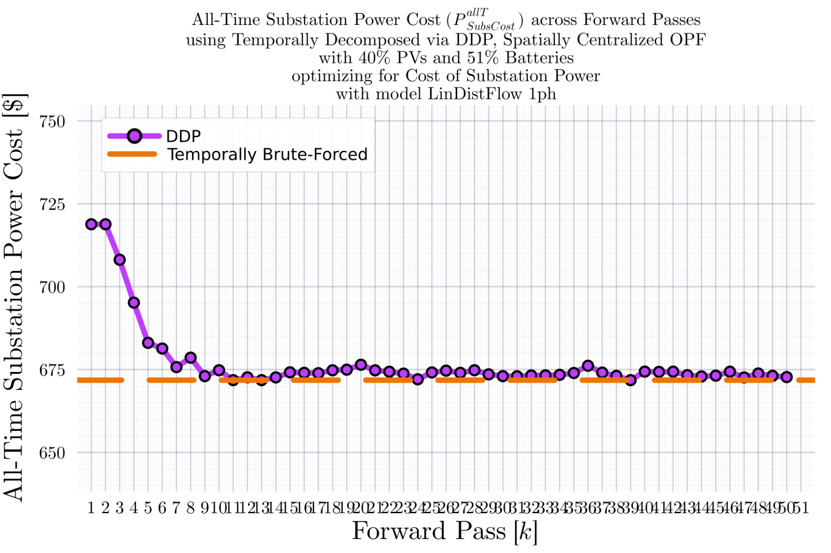

DDP Trajectory vs #Forward Passes $[k]$: LinDistFlow Model Terminal SOC Constraint Relaxed
$$IEEE123B_{\left\{1ph\right\}}, T=24$$
BruteForced (BF)
$$DDP$$
DDP didn’t converge in the given number of iterations..
$γ=1$ (no update damping)
$$k_{Max}=50$$

Slide 37


DDP Trajectory vs #Forward Passes $[k]$: LinDistFlow Model Terminal SOC Constraint Relaxed
$$IEEE123B_{\left\{1ph\right\}}, T=24$$
BruteForced (BF)
$$DDP$$
With some ‘convergence-catching’ heuristic in place (declare convergence if SOC and fval are not changing for 3 Forward Passes), DDP converges.
Tolerance:
fval: $\$0.1$
SOC: $0.01pu$
$γ=1$ (no update damping)
$$k_{Max}=50$$

Slide 38









DDP Trajectory vs #Forward Passes $[k]$: LinDistFlow Model Terminal SOC Constraint Relaxed
$$IEEE123A_{\left\{1ph\right\}}, T=24$$
BruteForced (BF)
$$DDP$$
$γ=1$ (no update damping)
$γ=1$ (no update damping)
$$γ=0.5$$
$$γ=0.5$$
$$k_{Max}=25$$

Slide 39









DDP Trajectory vs #Forward Passes $[k]$ Terminal SOC Constraint Relaxed
$$IEEE123A_{\left\{1ph\right\}}, T=3$$
BruteForced (BF)
$$DDP$$
$$FP\left(k\right):μ_{k}\left(t=1\right), μ_{k}\left(t=2\right), μ_{k}(t=3)$$
$$μ_{used}=\frac{μ^{k−1}+α∗μ^{k−2}}{1+α}$$
$$α^{k}=α_{0}∗γ^{k−2}$$
$$α_{0}=1.0$$
$γ=1$ (no update damping)
$$γ=0.5$$
$$k_{Max}=25$$
$γ=1$ (no update damping)
$$γ=0.5$$
Fluctuation ${\text{of} μ}_{k}^{T}$ value between $0$ and a ‘regular’ non-zero value

Slide 40








DDP Trajectory vs #Forward Passes $[k]$ Terminal SOC Constraint Relaxed
$$IEEE123A_{\left\{1ph\right\}}, T=6$$
BruteForced (BF)
$$DDP$$
$γ=1$ (no update damping)
$$γ=0.5$$
$γ=1$ (no update damping)
$$γ=0.5$$
$$k_{Max}=25$$

Slide 41





DDP Trajectory vs #Forward Passes $[k]$ Terminal SOC Constraint Relaxed
$$IEEE123A_{\left\{1ph\right\}}, T=24$$
BruteForced (BF)
$$DDP$$
$γ=1$ (no update damping)
$γ=1$ (no update damping)
$$γ=0.5$$
$$γ=0.5$$
$$k_{Max}=25$$

Slide 42



DDP Trajectory vs #Forward Passes $[k]$ Terminal SOC Constraint Relaxed
$$IEEE123A_{\left\{1ph\right\}}, T=96$$
BruteForced (BF)
$$DDP$$
$$k_{Max}=25$$

Slide 43










DDP Trajectory vs #Forward Passes $[k]$ Terminal SOC Constraint Relaxed
$$IEEE123B_{\left\{1ph\right\}}, T=96$$
BruteForced (BF)
$$DDP$$
$γ=1$ (no update damping)
$γ=1$ (no update damping)
$$k_{Max}=25$$

Slide 44








DDP Trajectory vs #Forward Passes $[k]$ Terminal SOC Constraint Relaxed
$$IEEE123B_{\left\{1ph\right\}}, T=24$$
BruteForced (BF)
$$DDP$$
$γ=1$ (no update damping)
$γ=1$ (no update damping)
$$γ=0.5$$
$$γ=0.5$$
$$k_{Max}=25$$

Slide 45




DDP Trajectory vs #Forward Passes $[k]$ Terminal SOC Constraint Relaxed
$$IEEE123B_{\left\{1ph\right\}}, T=24$$
BruteForced (BF)
$$DDP$$
$$k_{Max}=11$$

Slide 46




DDP Trajectory vs #Forward Passes $[k]$ Terminal SOC Constraint Relaxed
$$IEEE123B_{\left\{1ph\right\}}, T=24$$
$$DDP$$
$$k_{Max}=11$$

Slide 47




DDP Trajectory vs #Forward Passes $[k]$ Terminal SOC Constraint Relaxed
$$IEEE123B_{\left\{1ph\right\}}, T=24$$
BruteForced (BF)

Slide 48



DDP Trajectory vs #Forward Passes $[k]$ Terminal SOC Constraint Relaxed
$$IEEE123B_{\left\{1ph\right\}}, T=24$$
BruteForced (BF)
$$DDP$$
$$k_{Max}=7$$

Slide 49



DDP Trajectory vs #Forward Passes $[k]$ Terminal SOC Constraint Relaxed
$$IEEE123B_{\left\{1ph\right\}}, T=24$$
$$DDP$$
$$k_{Max}=11$$

Slide 50


DDP Trajectory vs #Forward Passes $[k]$ Terminal SOC Constraint Relaxed
$$IEEE123B_{\left\{1ph\right\}}, T=24$$
BruteForced (BF)
$$DDP$$
$$k_{Max}=25$$

Slide 51



DDP Trajectory vs #Forward Passes $[k]$ Terminal SOC Constraint Relaxed
$$IEEE123B_{\left\{1ph\right\}}, T=24$$
$$DDP$$
$$k_{Max}=25$$

Slide 52


IEEE 730 1ph Node System
34 12.66kV to 12.66kV branches (high impedance)
43 12.66kV to 0.24kV branches (low impedance)
$$k{V_{B}}_{Sys}=0.24$$
$$kV_{B_{Sec}}=0.24$$
$$kV_{B_{Pri}}=12.66$$
$$MV{A_{B}}_{Sys}=100$$
$$MVA_{B_{Xfm}}=0.07$$
$$Z_{B_{Sys}}=Z_{B_{Sec}}=0.000576$$
$$Z_{B_{Pri}}=1.602756$$
1
2
2
2
1
4
1
1
1
0
1
4
1
1
1
1
2
1
2
1
1
1
1
1
1
1
1
1
1
1
1
1
0
1
0
1

Slide 53


Comparison of BFM-NL-1ph and LinDistFlow-1ph Optimization Results
LinDistFlow Optimal Actions used in OpenDSS
BFM-NL
Optimal Actions used in OpenDSS

Slide 54


Comparison of BFM-NL-1ph and LinDistFlow-1ph Optimization Results
LinDistFlow Own Solutions
BFM-NL Own Solutions

Slide 55


Comparison of BFM-NL-1ph and LinDistFlow-1ph Optimization Results
LinDistFlow
BFM-NL

Slide 56








DDP Trajectory vs #Forward Passes $[k]$ Terminal SOC Constraint Relaxed
$$ADS{10}_{1ph}, T=96$$
BruteForced (BF)
$$DDP$$
Looks ‘successful’
$$k_{Max}=33$$

Slide 57







DDP Trajectory vs #Forward Passes $[k]$ Terminal SOC Constraint Relaxed
$$IEEE{123}_{1ph}, T=96$$
BruteForced (BF)
$$DDP$$
Looks ‘successful’
$$k_{Max}=33$$

Slide 58







DDP Trajectory vs #Forward Passes $[k]$ Terminal SOC Constraint Relaxed
$$ADS{10}_{1ph}, T=24$$
BruteForced (BF)
$$DDP$$
Looks ‘successful’
$$k_{Max}=33$$

Slide 59






DDP Trajectory vs #Forward Passes $[k]$ Terminal SOC Constraint Relaxed
$$IEEE{123}_{1ph}, T=24$$
BruteForced (BF)
$$DDP$$
Looks ‘successful’
$$k_{Max}=33$$

Slide 60







DDP Trajectory vs #Forward Passes $[k]$ Terminal SOC Constraint Relaxed
$$ADS{10}_{1ph}, T=12$$
BruteForced (BF)
$$DDP$$
Will NOT converge
$$k_{Max}=33$$
Even if not converging, it at least does ‘hit’ the optimal value periodically.

Slide 61



DDP Trajectory vs #Forward Passes $[k]$ Terminal SOC Constraint Relaxed
$$ADS{10}_{1ph}, T=12$$
BruteForced (BF)
$$DDP$$
Will NOT converge
$$k_{Max}=55$$
Even if not converging, it at least does ‘hit’ the optimal value periodically.

Slide 62




DDP Trajectory vs #Forward Passes $[k]$ Terminal SOC Constraint Relaxed
$$ADS{10}_{1ph}, T=12$$
BruteForced (BF)
$$DDP$$
Will NOT converge
$$k_{Max}=77$$
Even if not converging, it at least does ‘hit’ the optimal value periodically.

Slide 63




DDP Trajectory vs #Forward Passes $[k]$ Terminal SOC Constraint Relaxed
$$ADS{10}_{1ph}, T=12$$
BruteForced (BF)
$$DDP$$
Will NOT converge
$$k_{Max}=222$$
Even if not converging, it at least does ‘hit’ the optimal value periodically.

Slide 64







DDP Trajectory vs #Forward Passes $[k]$ Terminal SOC Constraint Relaxed
$$IEEE{123}_{1ph}, T=12$$
BruteForced (BF)
$$DDP$$
Will NOT converge
$$k_{Max}=33$$
Even if not converging, it at least does ‘hit’ the optimal value periodically.

